Slide 1

Review Analysis of Product
Team - 1
Mentor1:- Varun Vennelaganti
Mentor2:- Deepika P
Group Member:-
Ashutosh Jha
Sameer Herkal
Suresh Solanki
Aditya Mhadye
Apeksha Singh
More Murali Krishna
Vivek Naredla

Slide 2
Business Problem:
Objective:
Business Objective:
Most of the people are expressing their view by posting it on social platforms about a product. We need to understand the liking or disliking of that product to help the organization to make some decisions about the production and supply of the same in the market. So here consider extracting reviews from ecommerce websites and analyze them to satisfy the objective.
Architecture level analysis:
Understand the business statement how we can approach
EDA should be done on the given dataset.
Model to get the sentiment result.
Deployment through Flask.

Slide 3
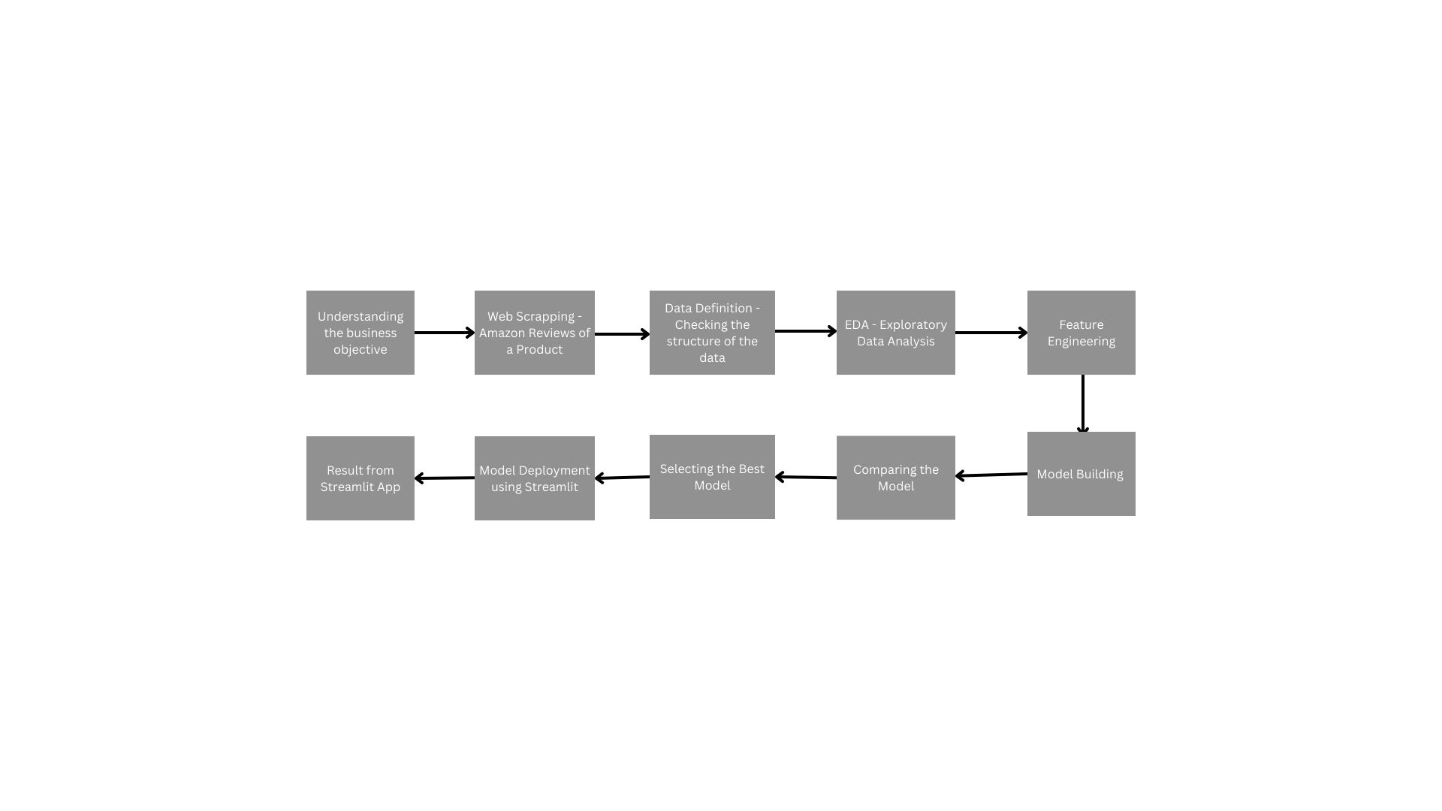
Project Architecture / Project Flow

Slide 4
Exploratory Data Analysis (EDA) & Feature Engineering

Slide 5
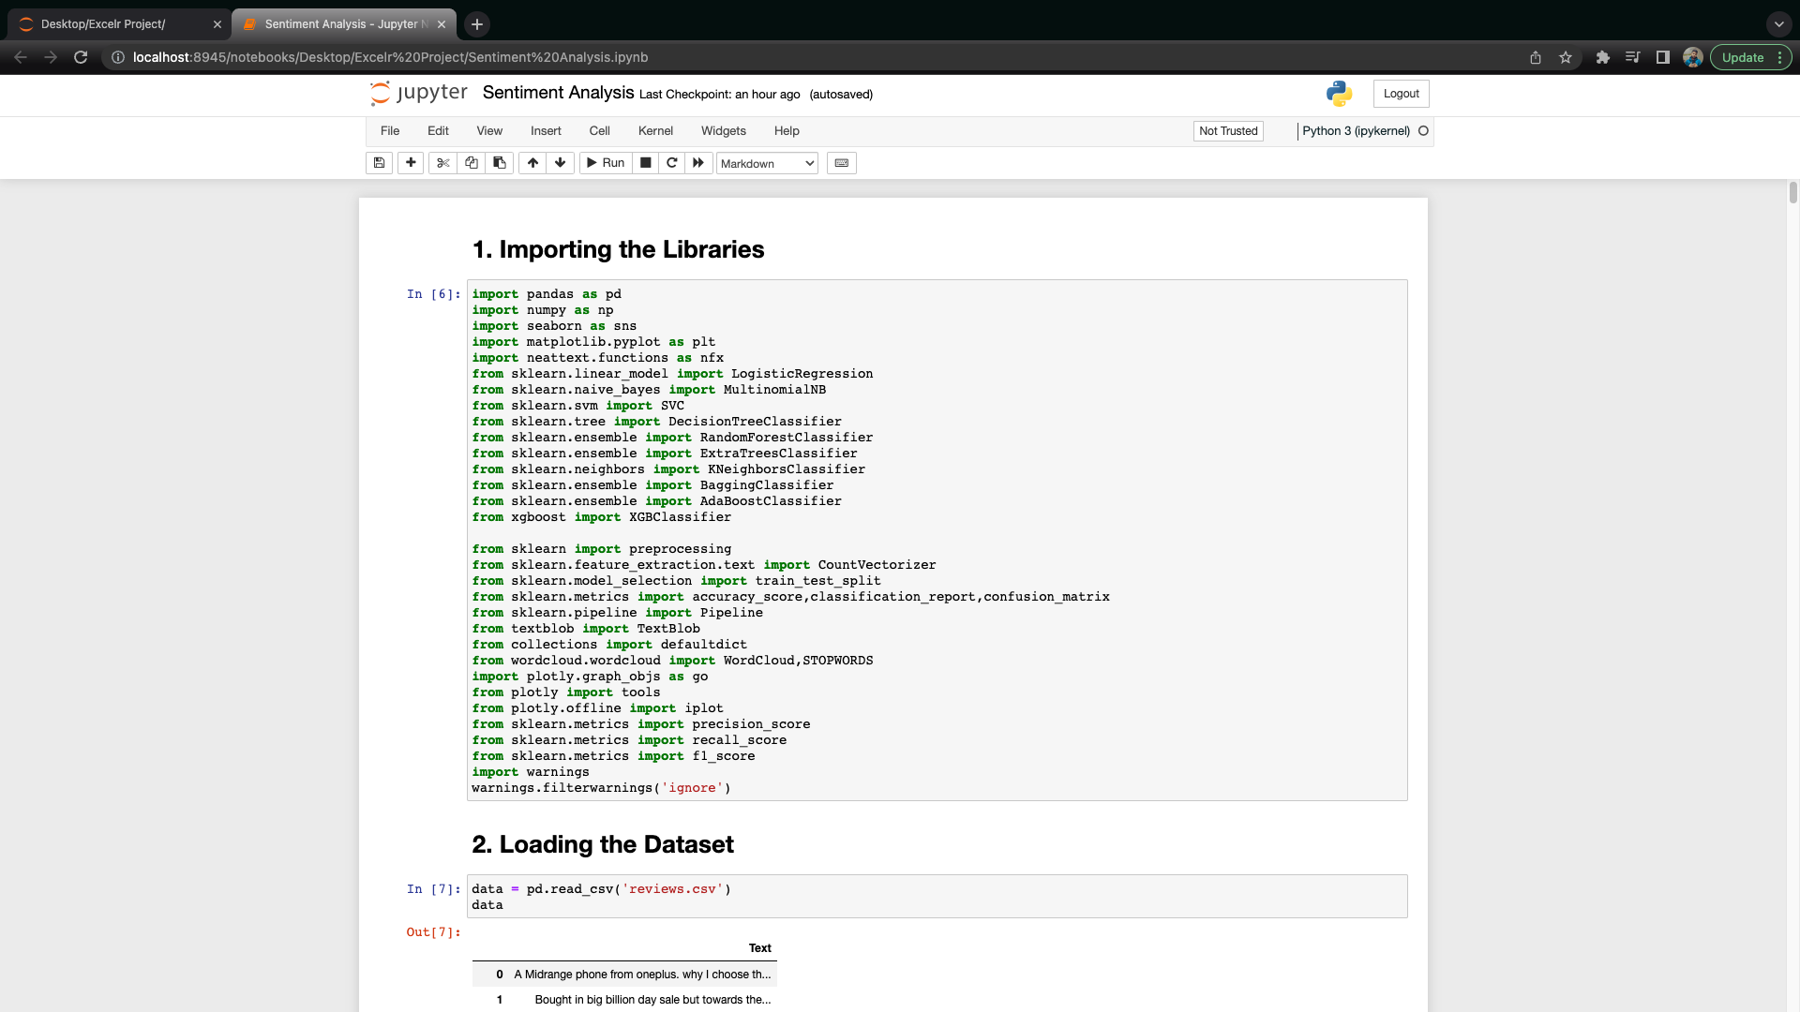
1. Libraries

Slide 6
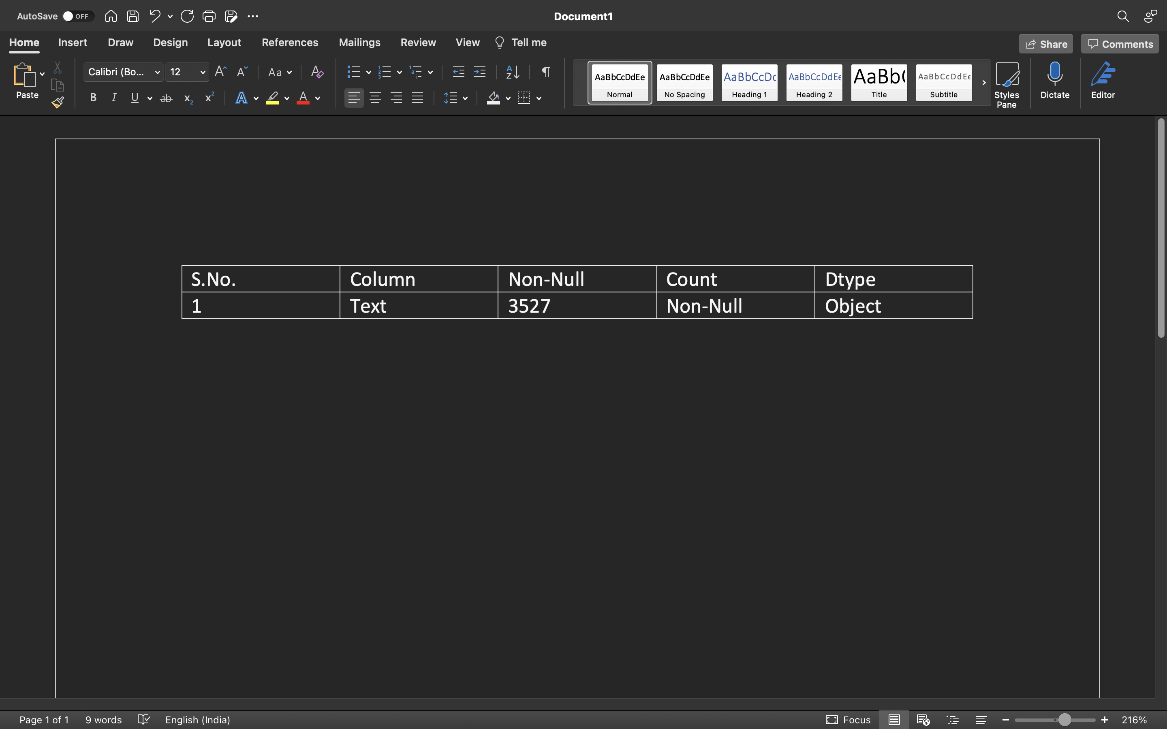
2.Data set details
Independent Variable / Features :- Text
Dependent Variable / Target Variable :- Sentiment
Shape of dataset :- (3710,1)

Slide 7
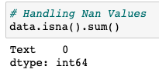
3.Exploratory Data Analysis (EDA)
3.1. Handling NaN Values
We have got 184 null values in Text column, so will drop those missing values.
After dropping we don’t have any Nan values.

Slide 8
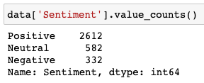
3.Exploratory Data Analysis (EDA)
3.2. Creating the Sentiment Column
We created polarity column in which we calculated the polarity of each review and based on the polarity we have given the Names to each polarity.
If Polarity < 0 -> Negative
If Polarity = 0 -> Neutral
If Polarity > 0 -> Positive

Slide 9
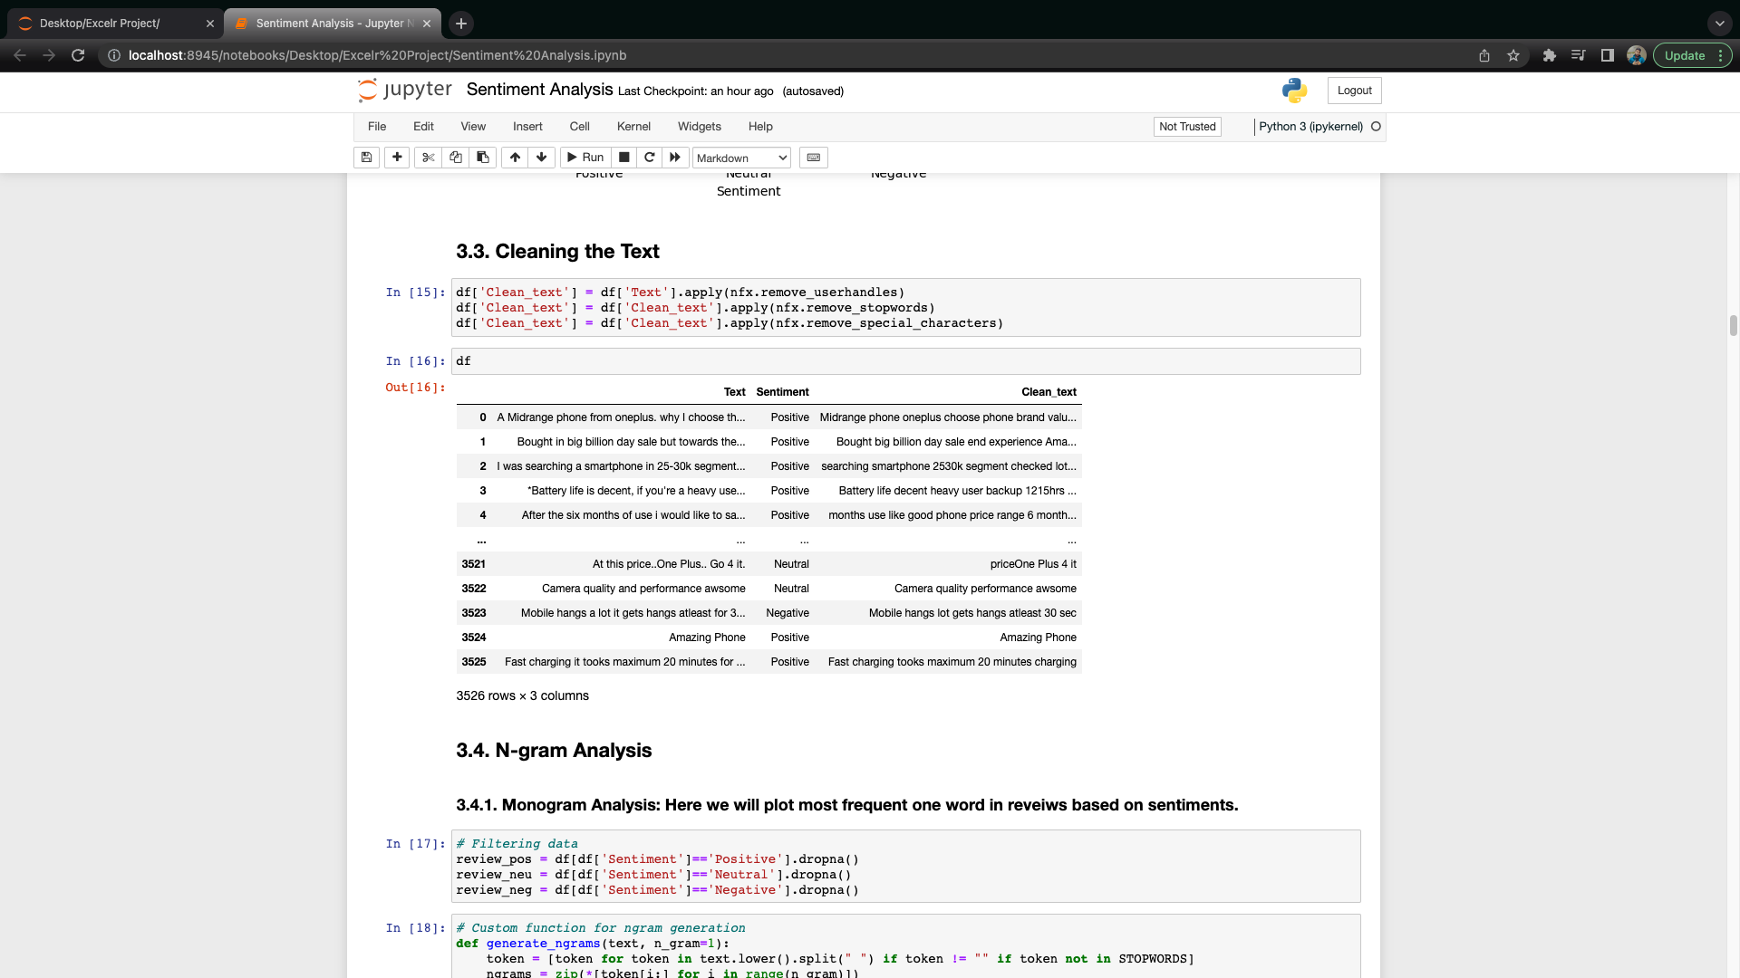
Exploratory Data Analysis (EDA)
3.3. Cleaning the Text
In this part, we have removed all punctuation form ‘Text’ column.
In this part, we have removed all stopwords form ‘Text’ column.
In this part, we have removed all special character's form ‘Text’ column.

Slide 10
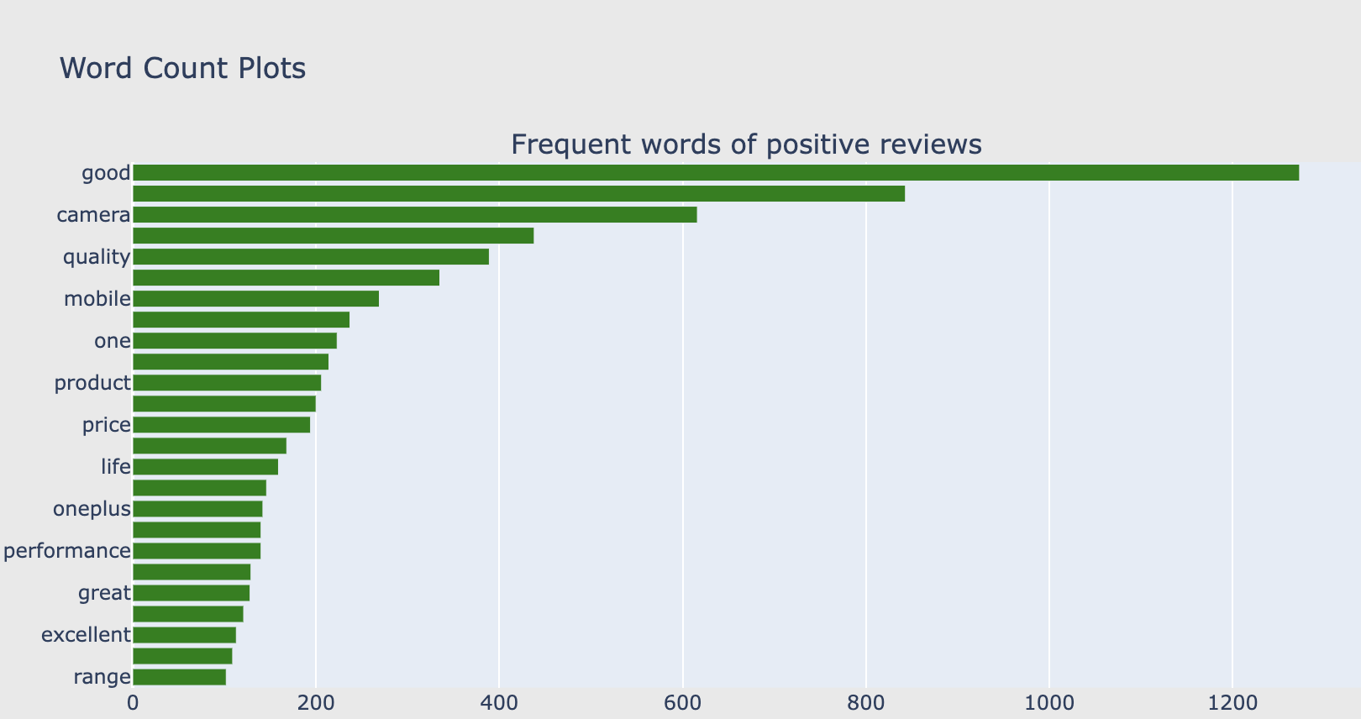
3.Exploratory Data Analysis (EDA)
3.4. N-gram Analysis
3.4.1 Mono-Gram Analysis

Slide 11
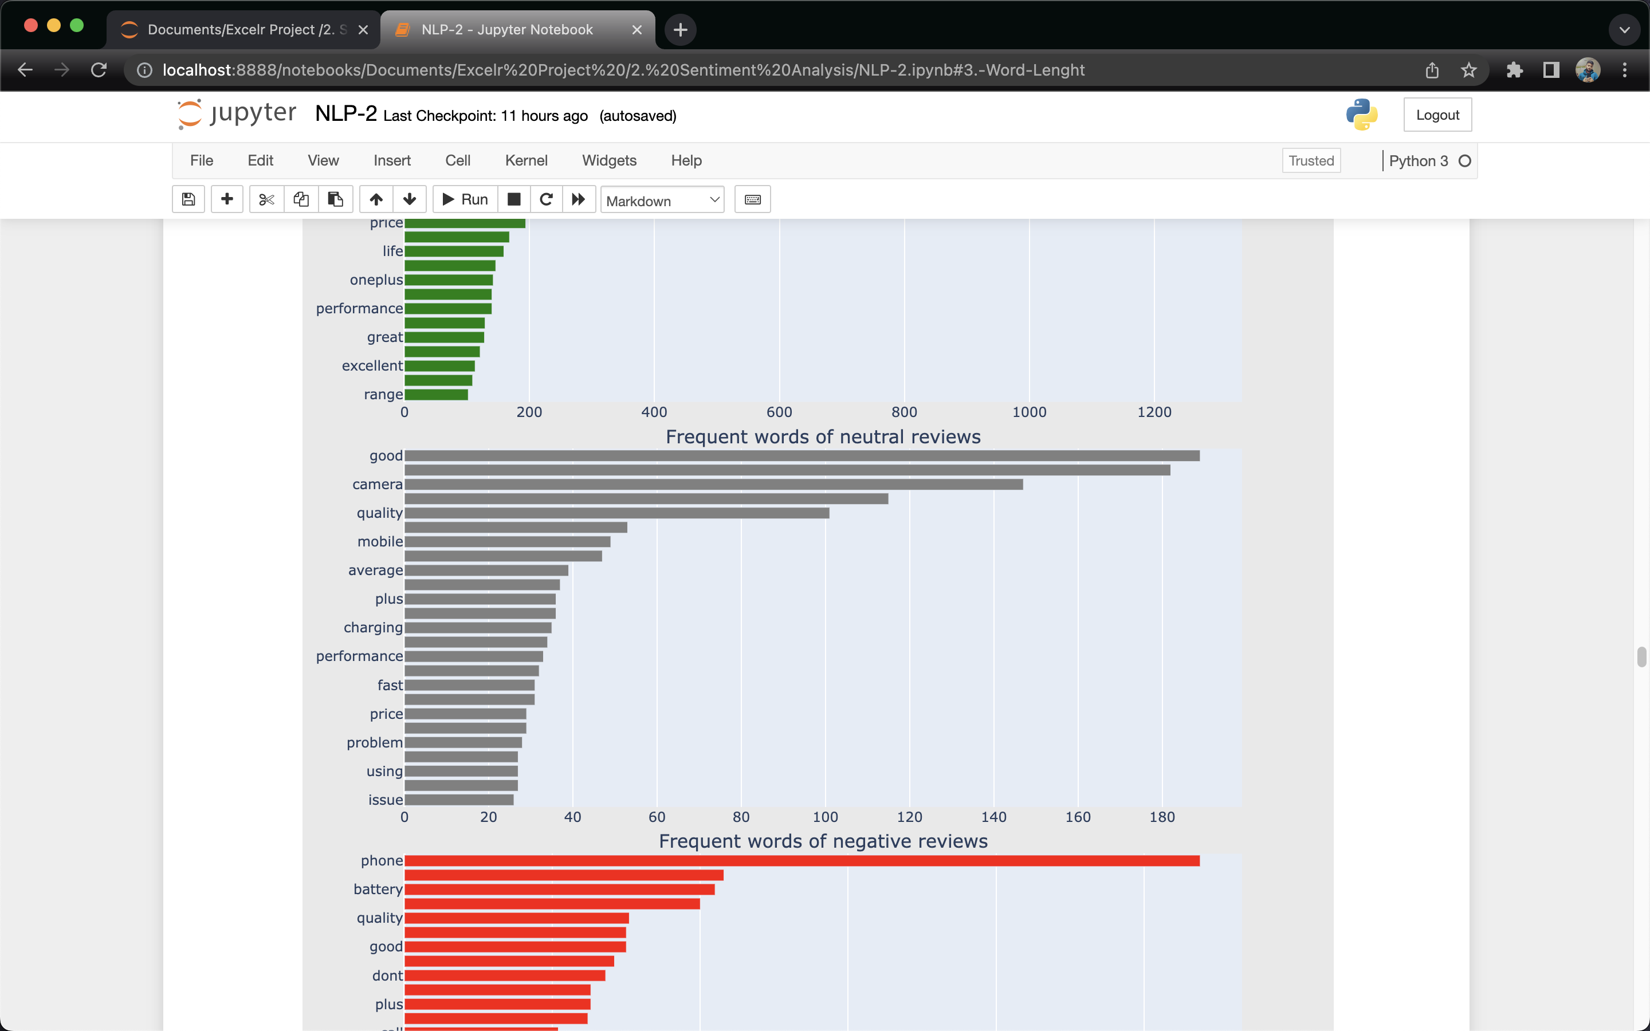
3.Exploratory Data Analysis (EDA)
3.4. N-gram Analysis
3.4.1 Mono-Gram Analysis

Slide 12
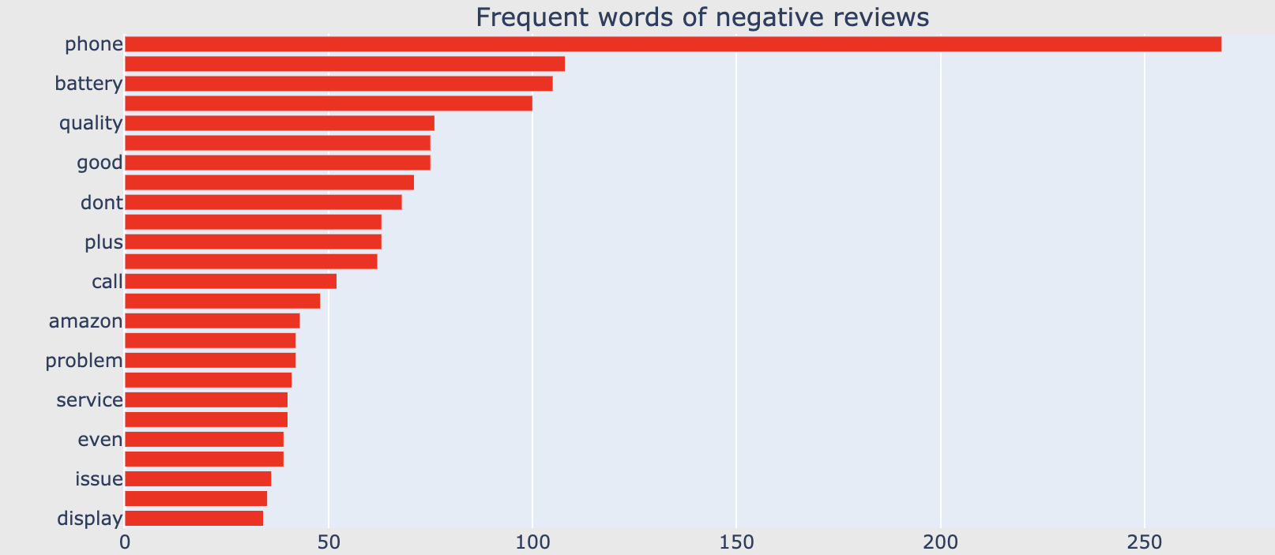
3.Exploratory Data Analysis (EDA)
3.4. N-gram Analysis
3.4.1 Mono-Gram Analysis
Insights:
1. As we see, the words doesn't match with the sentiment except few. Through monogram we can't judge a sentiment based on one word. So, let's try with frequent two words.

Slide 13
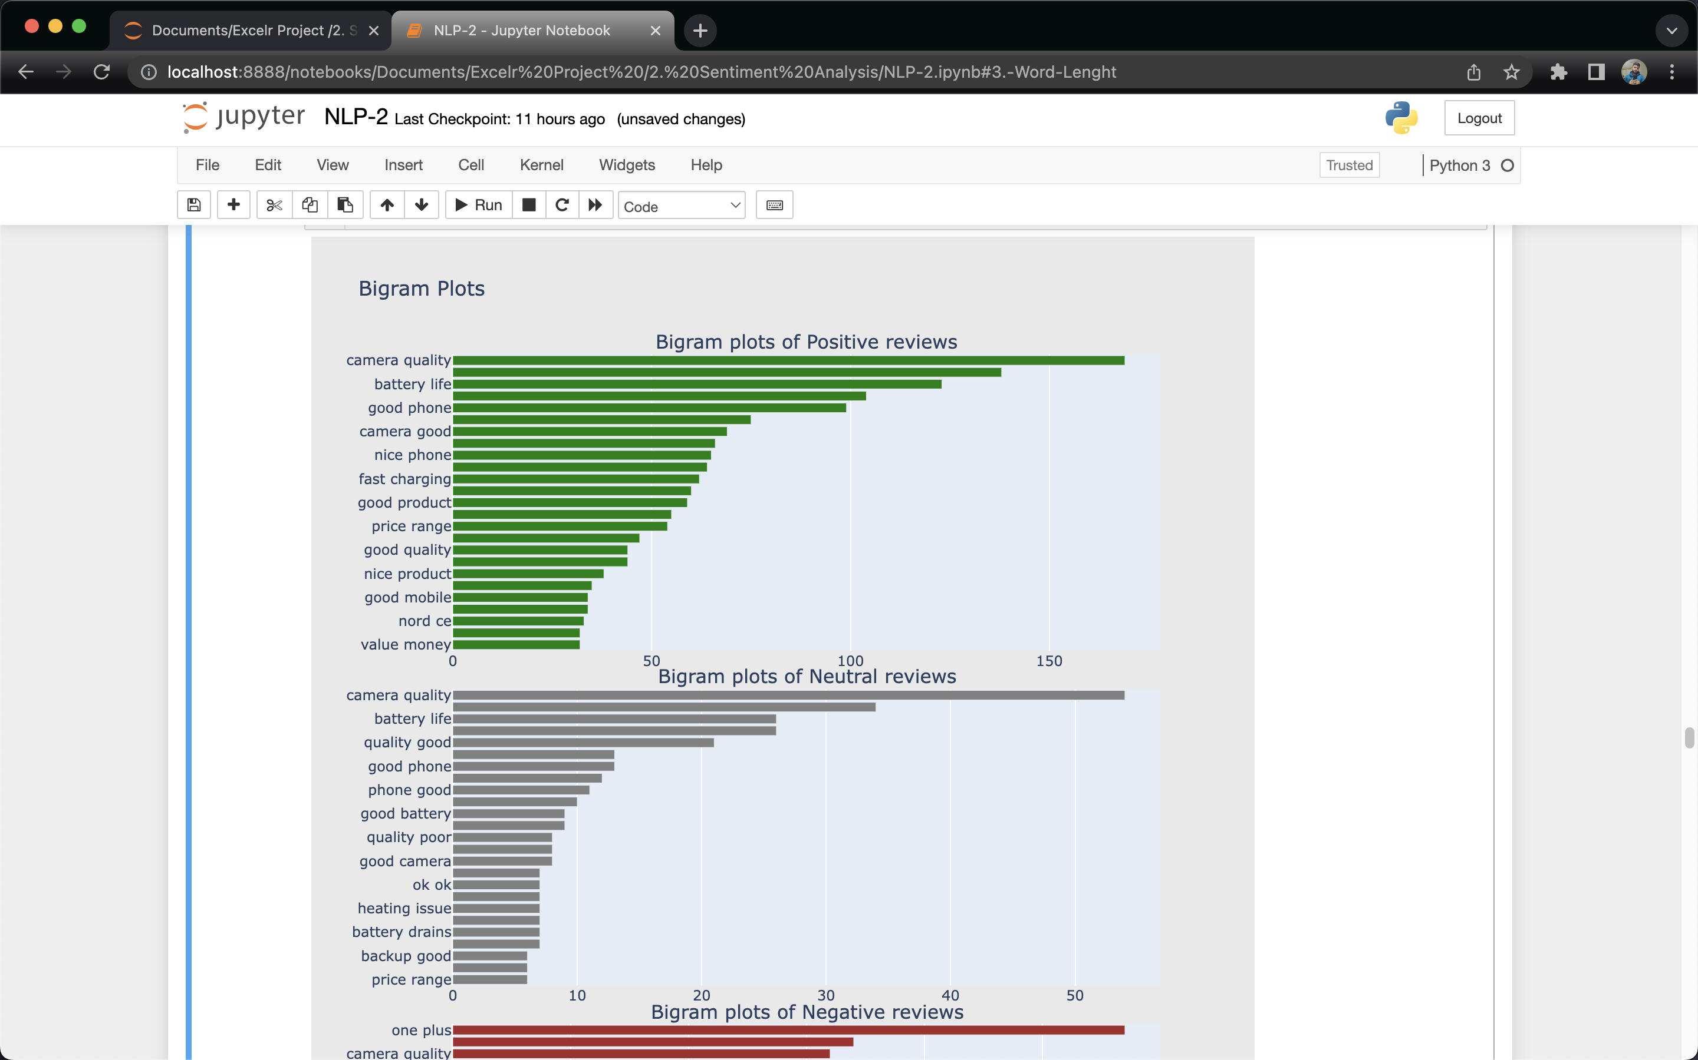
3.Exploratory Data Analysis (EDA)
3.4. N-gram Analysis
3.4.2 BI-Gram Analysis

Slide 14
3.Exploratory Data Analysis (EDA)
3.4. N-gram Analysis
3.4.2 BI-Gram Analysis

Slide 15
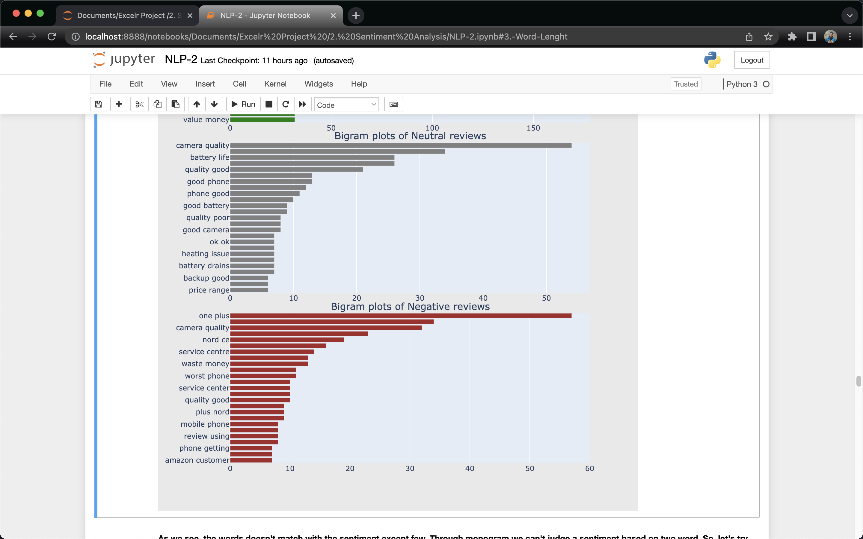
3.Exploratory Data Analysis (EDA)
3.4. N-gram Analysis
3.4.2 BI-Gram Analysis
Insights:
1.As we see, the words doesn't match with the sentiment except few. Through monogram we can't judge a sentiment based on two word. So, let's try with frequent three words.

Slide 16
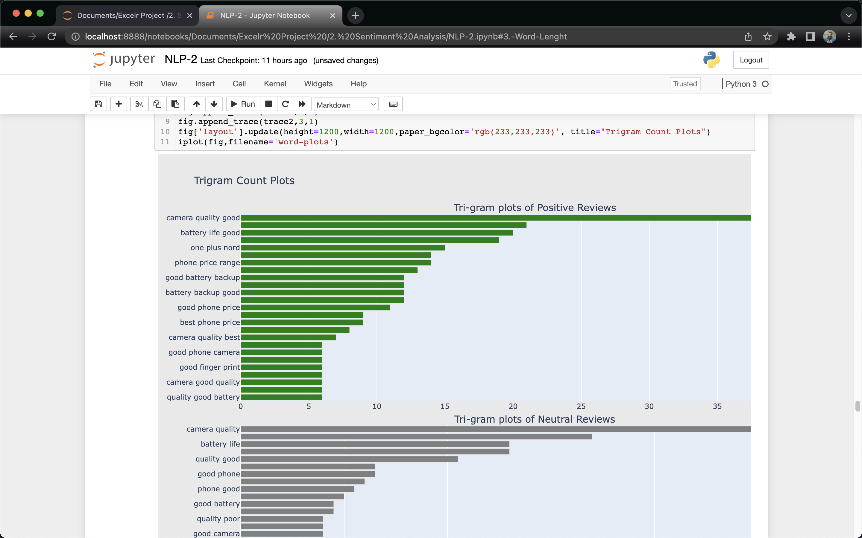
3.Exploratory Data Analysis (EDA)
3.4. N-gram Analysis
3.4.3 Tri-Gram Analysis

Slide 17
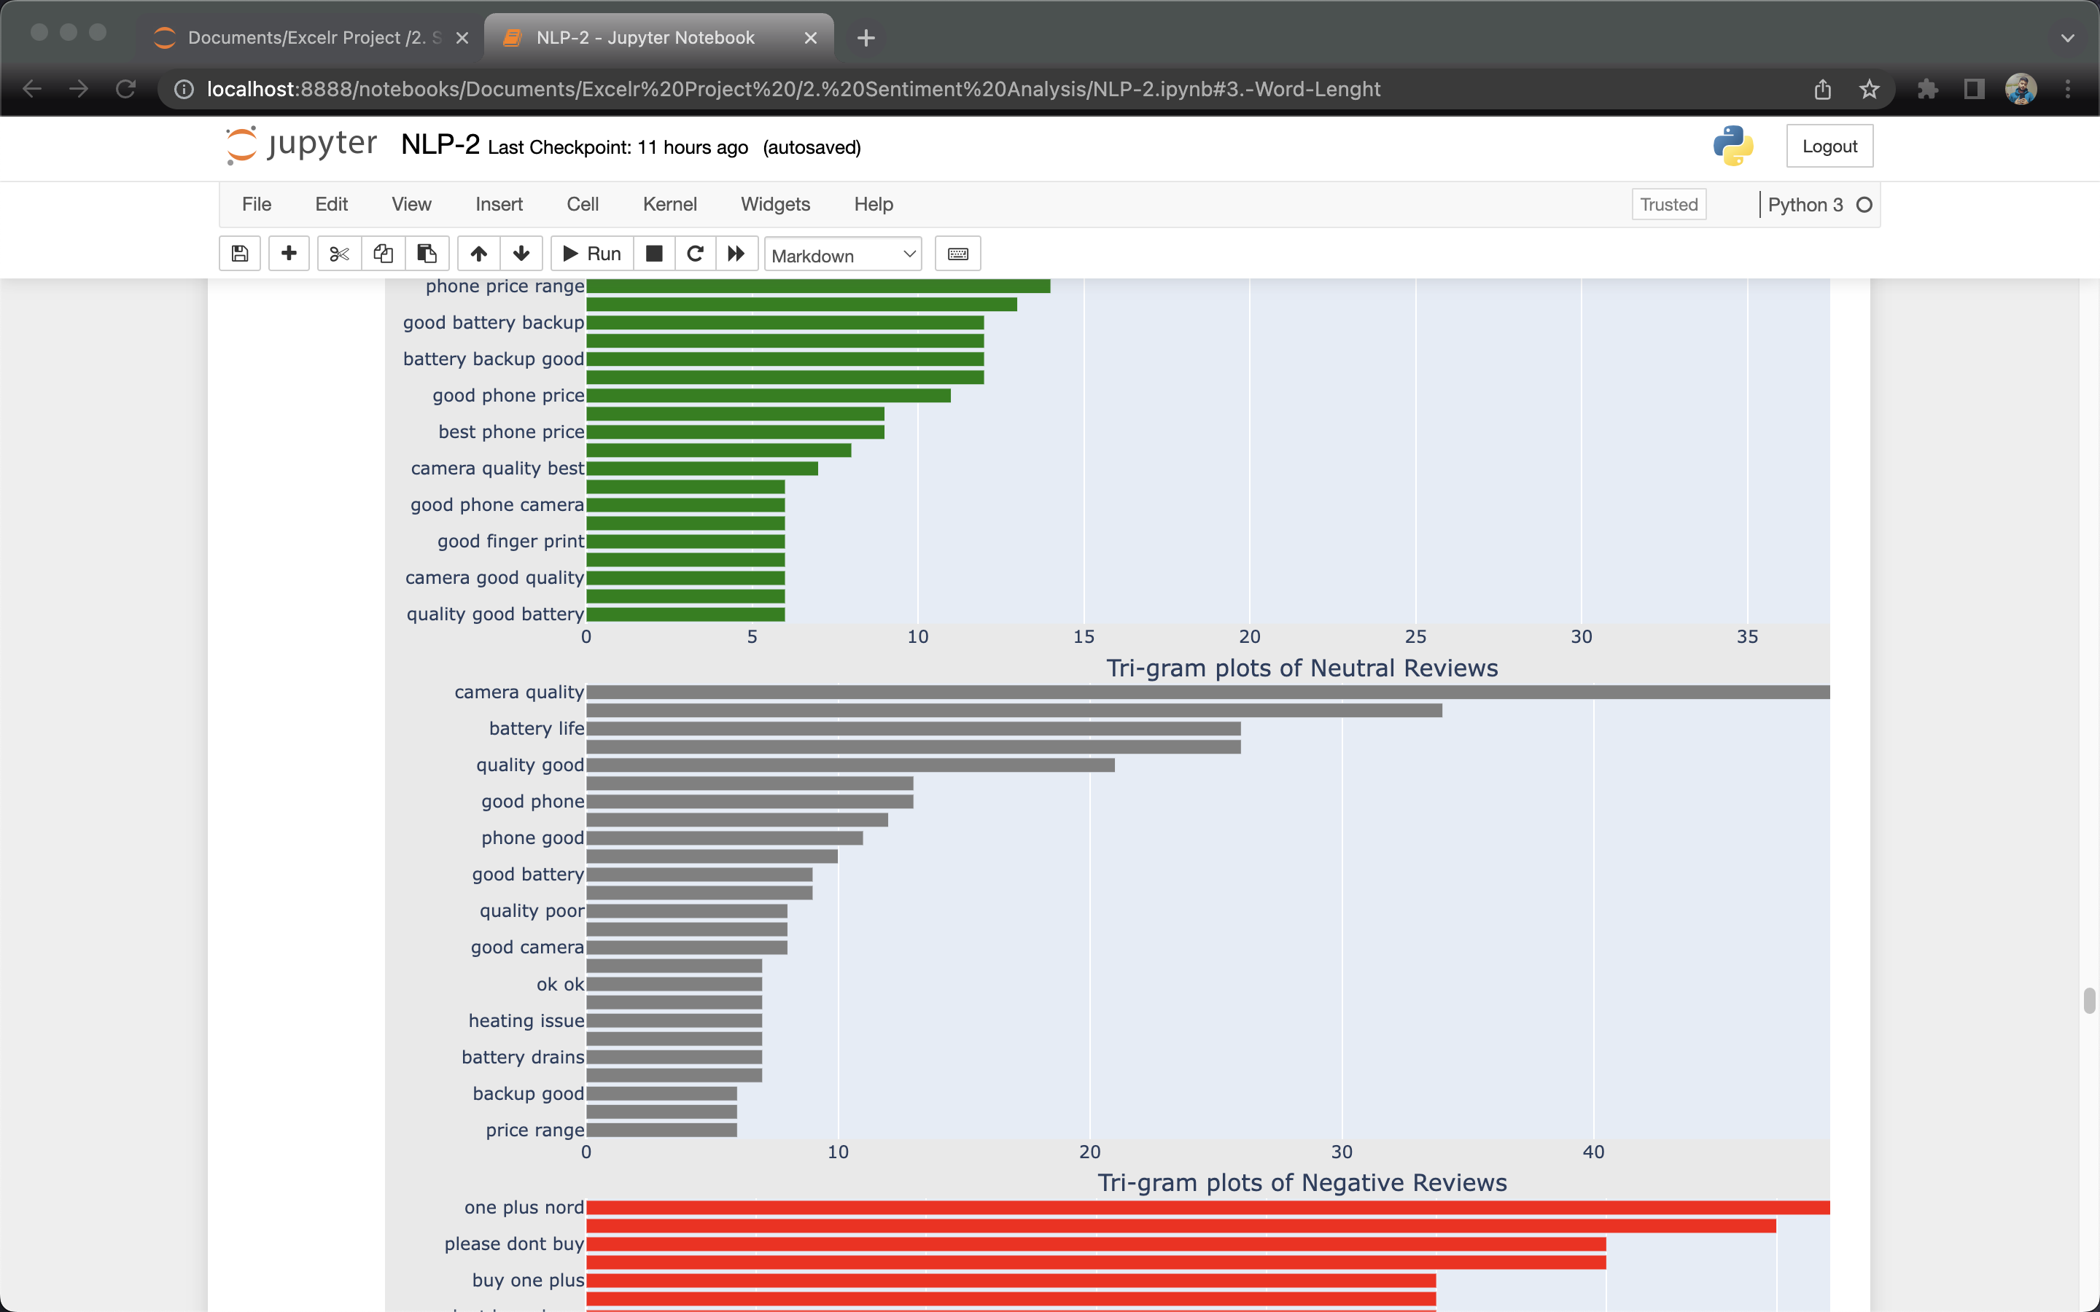
3.Exploratory Data Analysis (EDA)
3.4. N-gram Analysis
3.4.3 Tri-Gram Analysis

Slide 18
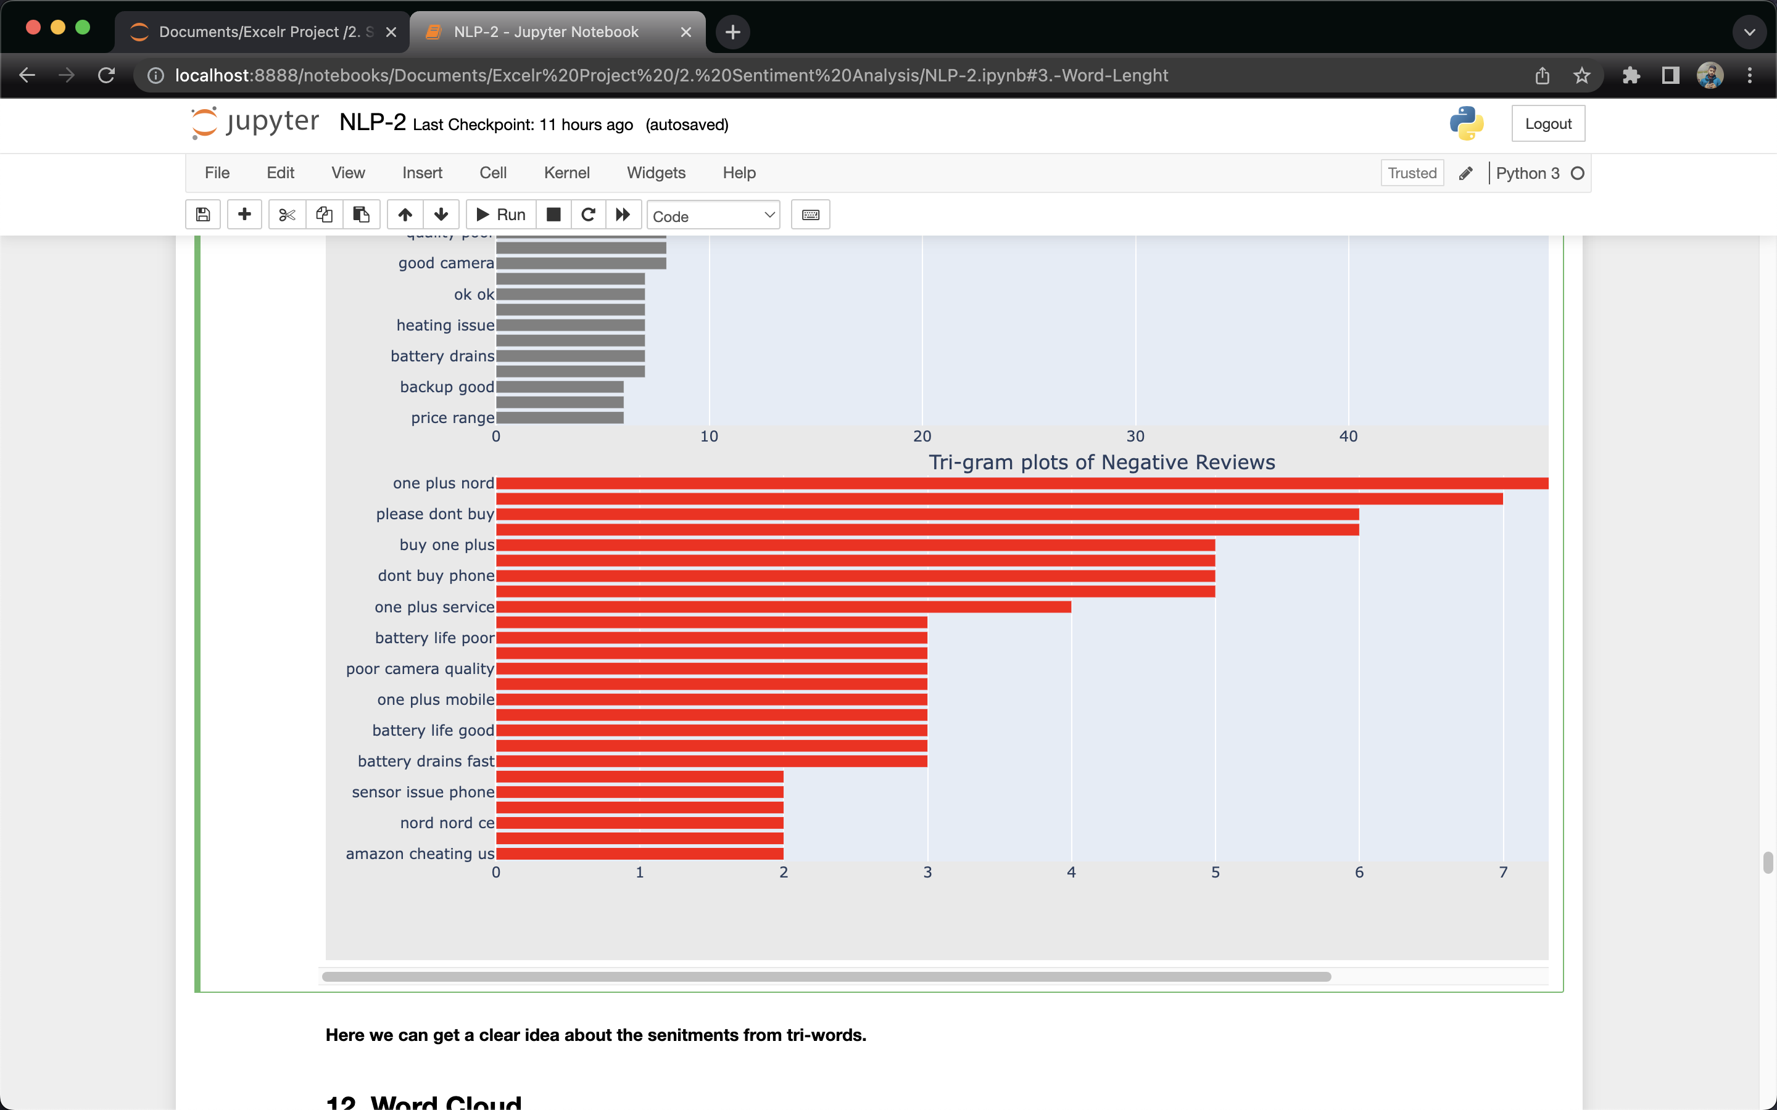
3.Exploratory Data Analysis (EDA)
3.4. N-gram Analysis
3.4.3 Tri-Gram Analysis
Insights:
1. Here we can get a clear idea about the sentiments from tri-words.

Slide 19
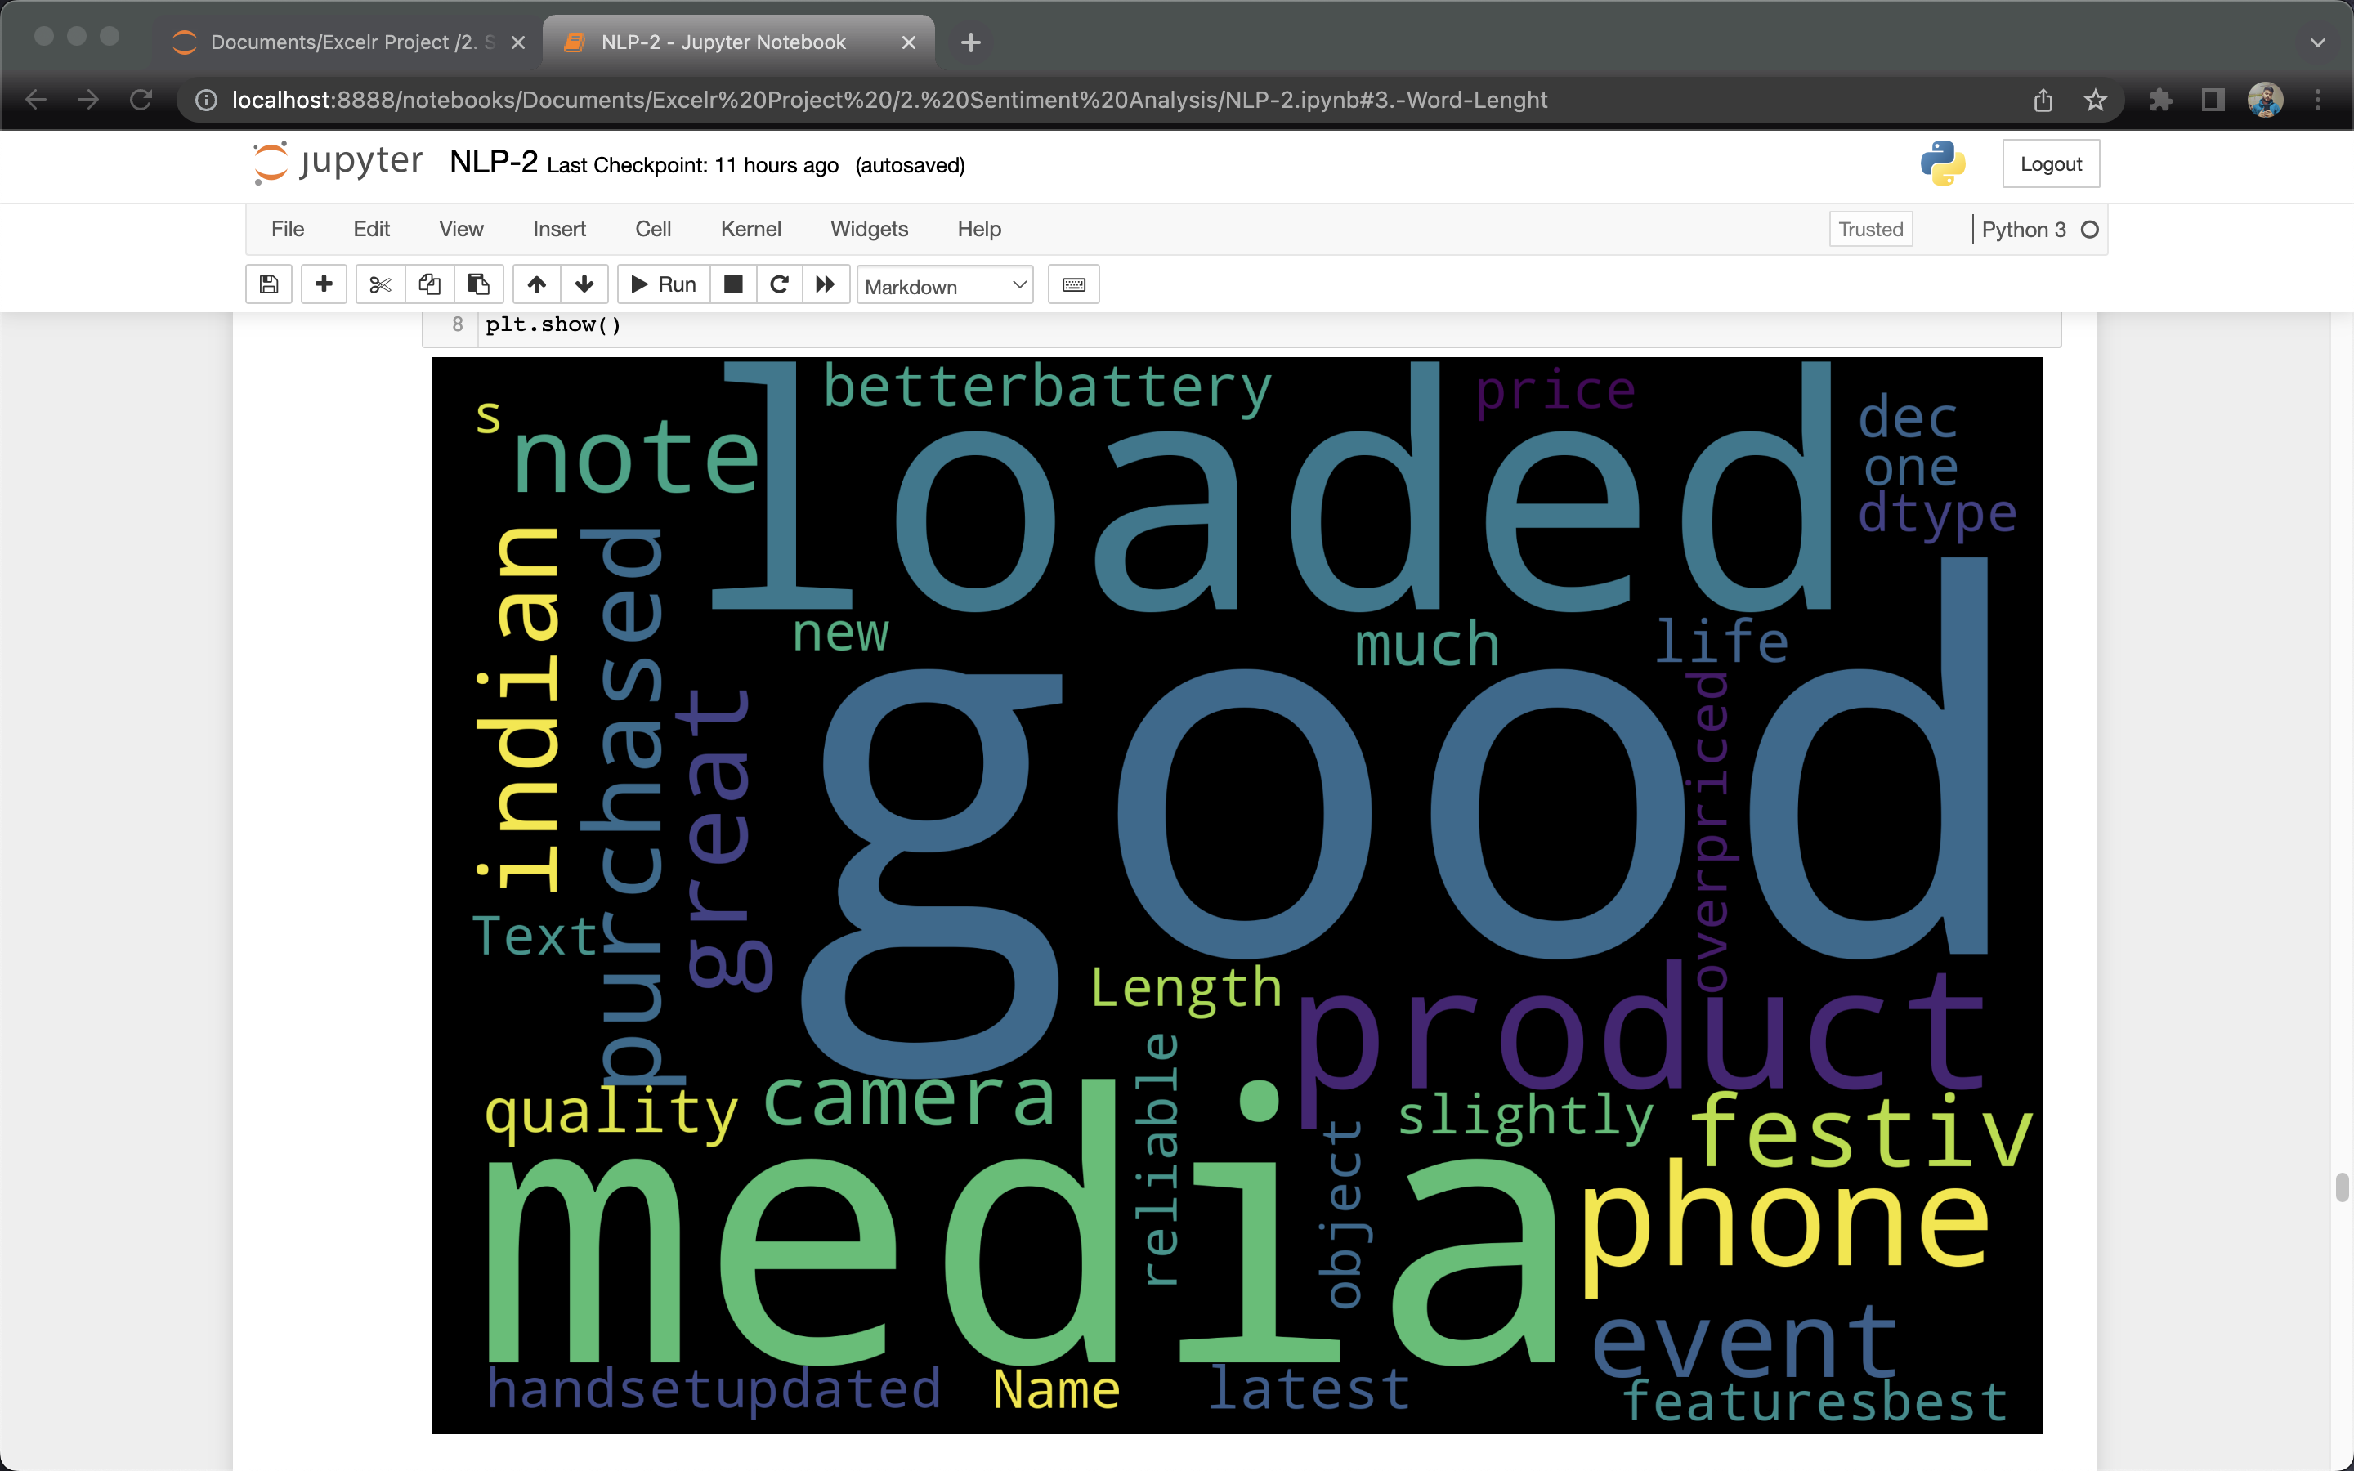
3.Exploratory Data Analysis (EDA)
3.5. Word Cloud
3.5.1. Positive Word Cloud
Insights:
1. We can see positive words like good, media, loaded, indian etc.

Slide 20
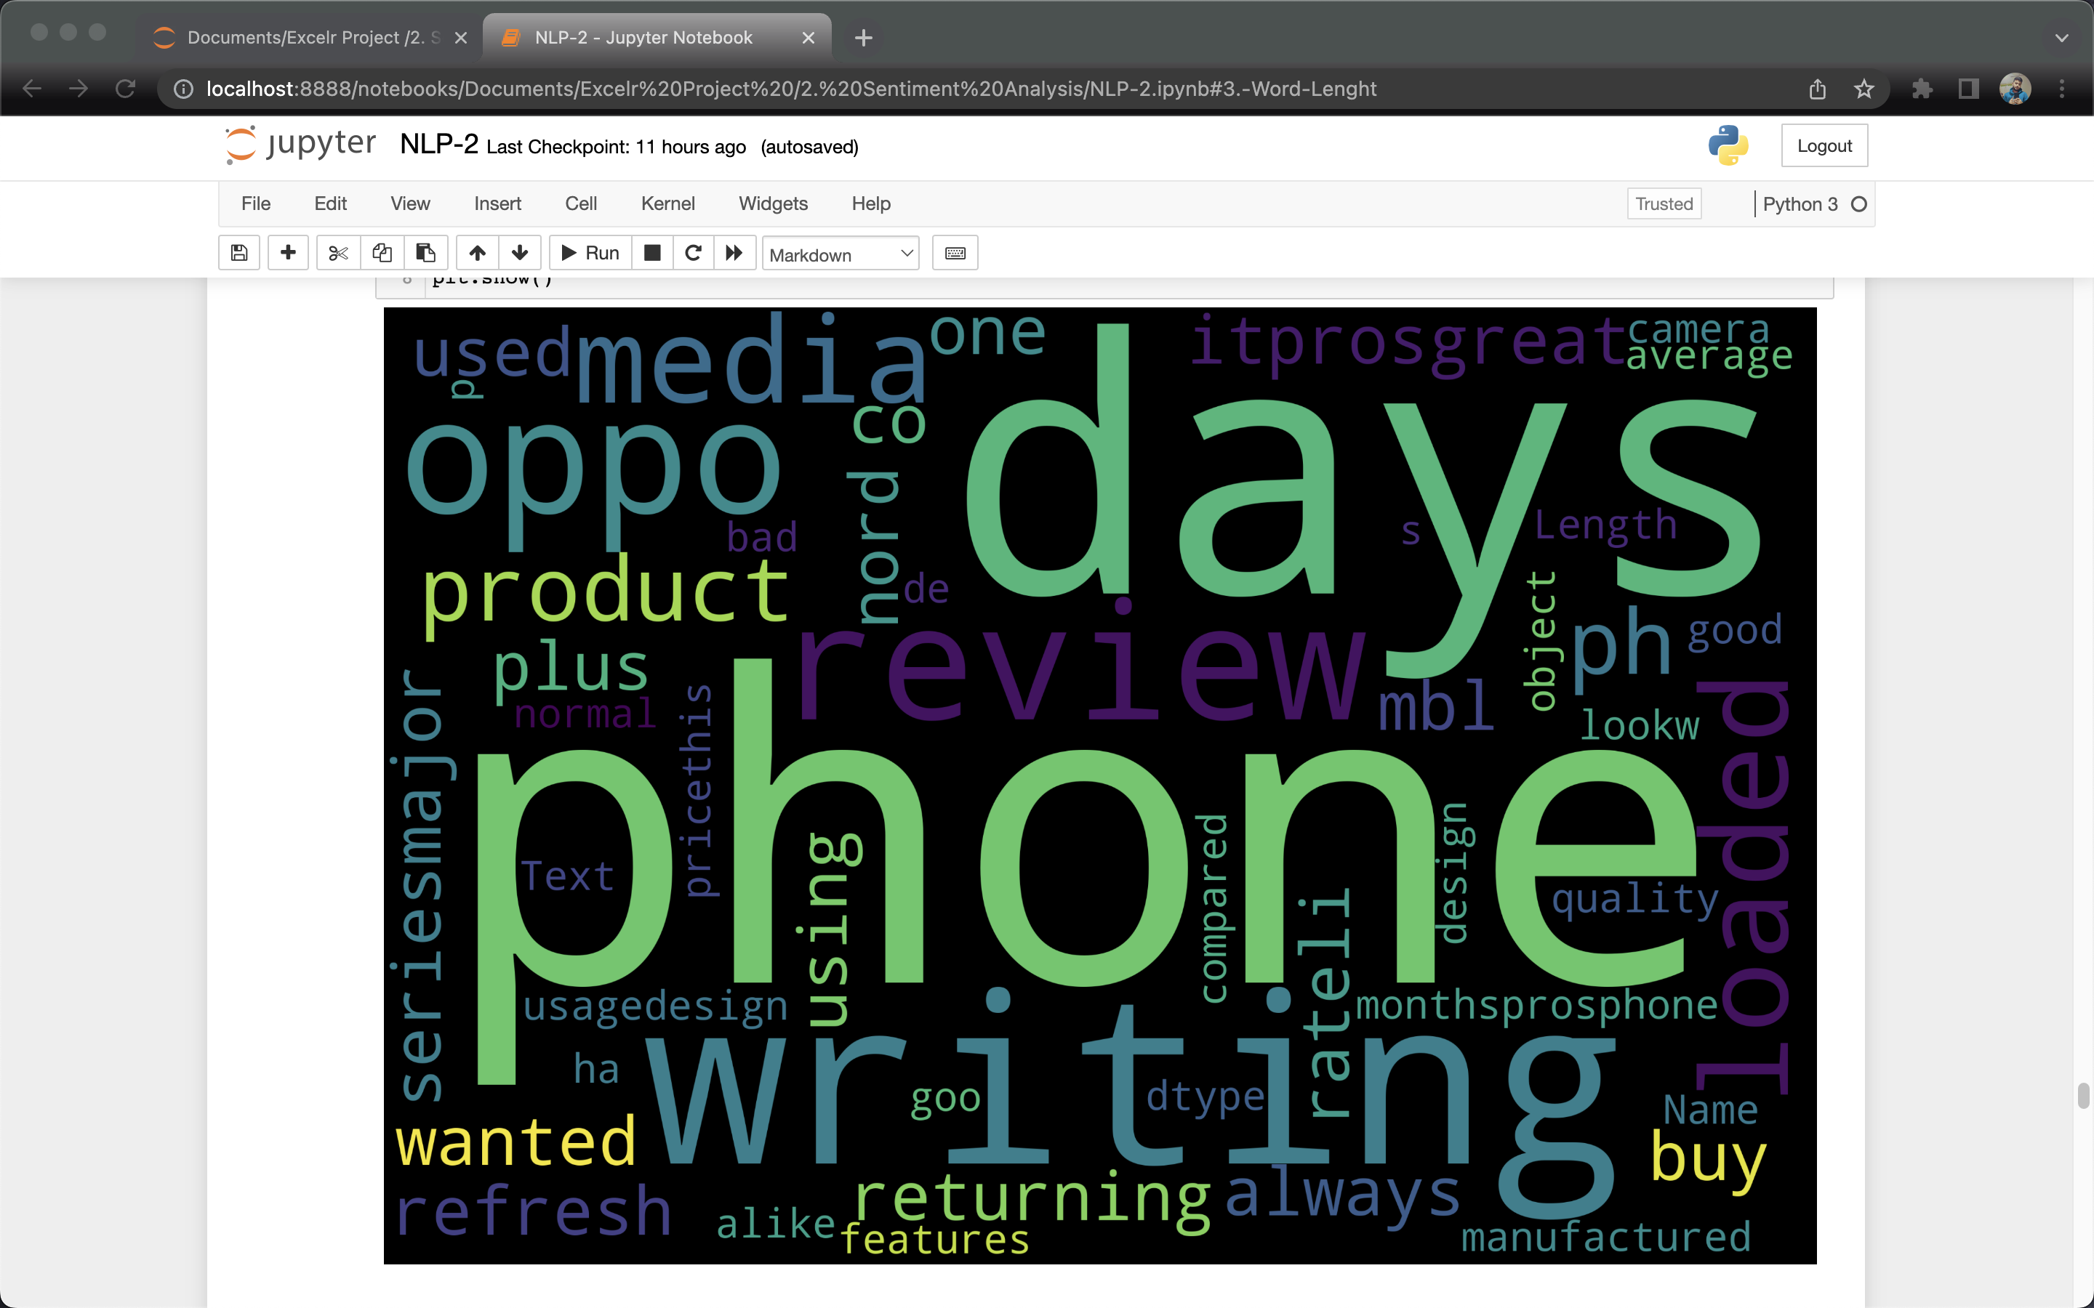
3.Exploratory Data Analysis (EDA)
3.5. Word Cloud
3.5.2 Neutral Word Cloud
Insights:
1. Most of the neutral words are focused on the product and how can they be improved.

Slide 21
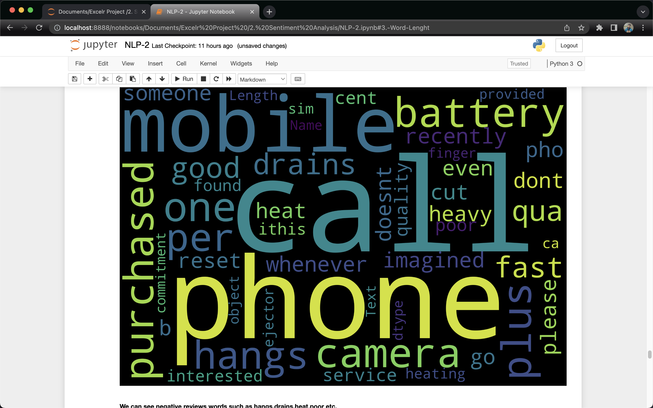
3.Exploratory Data Analysis (EDA)
3.5. Word Cloud
3.5.3 Negative Word Cloud
Insights:
1. We can see negative reviews words such as hangs, drains, heat, poor etc.

Slide 22
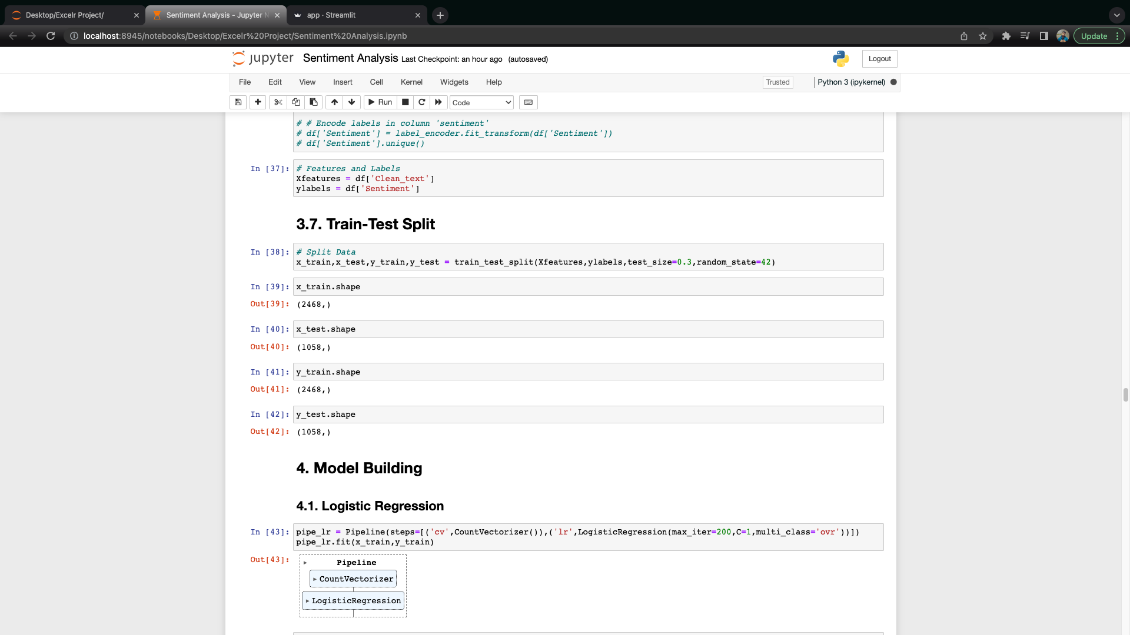
3.Exploratory Data Analysis (EDA)
3.6. Train-Test Split

Slide 23
4.Model Building

Slide 24
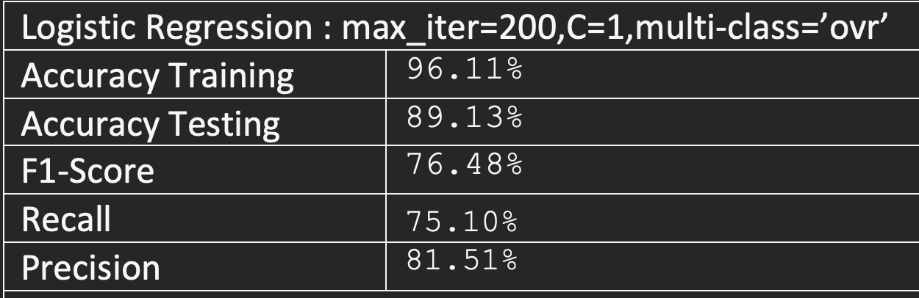
4.1 : Logistic Regression

Slide 25
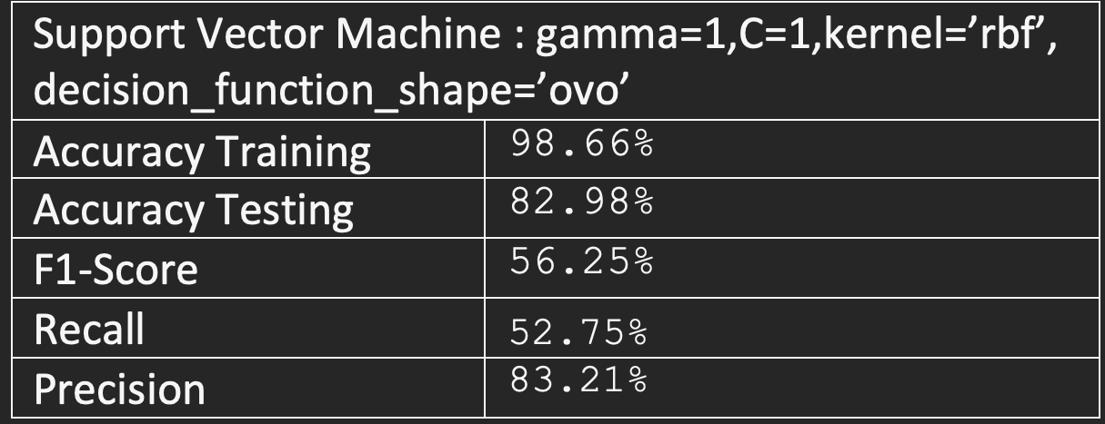
4.2 : Support Vector Machine

Slide 26
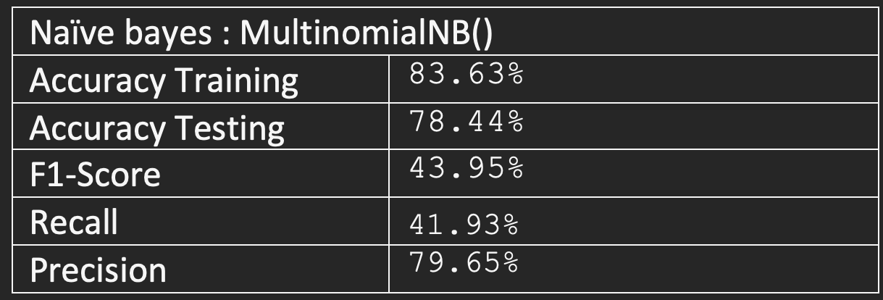
4.3 : Naïve Bayes

Slide 27
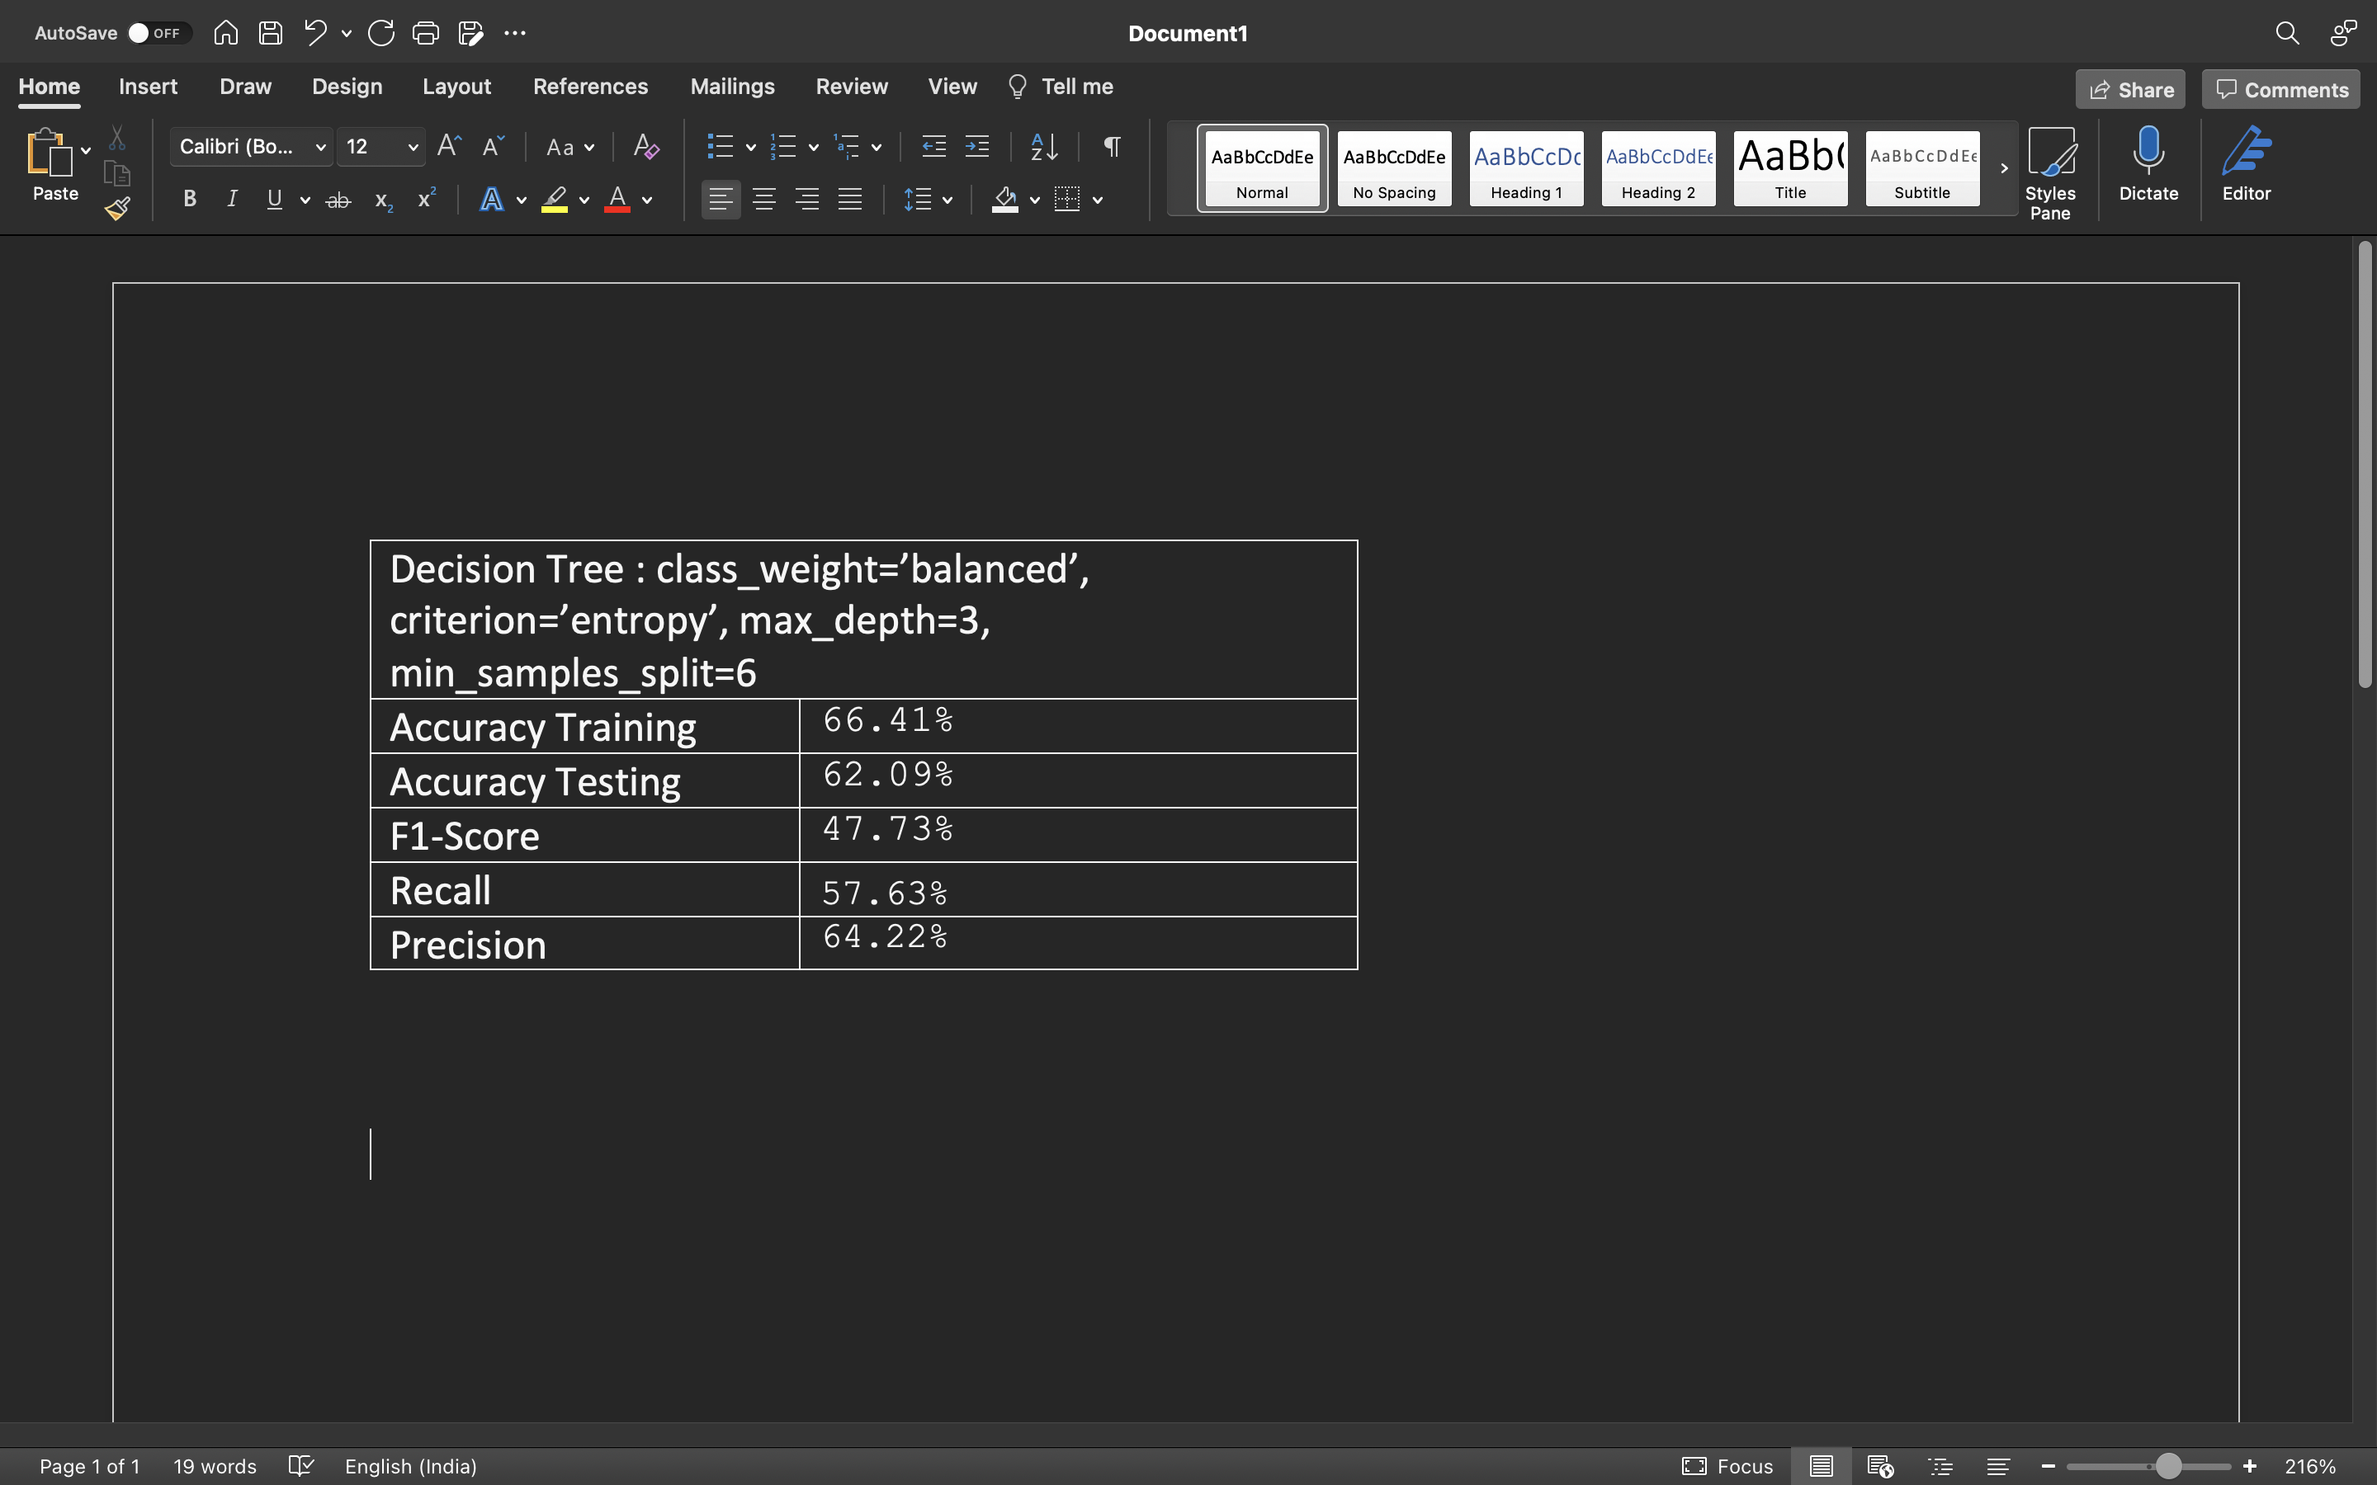
4.4 : Decision Tree

Slide 28
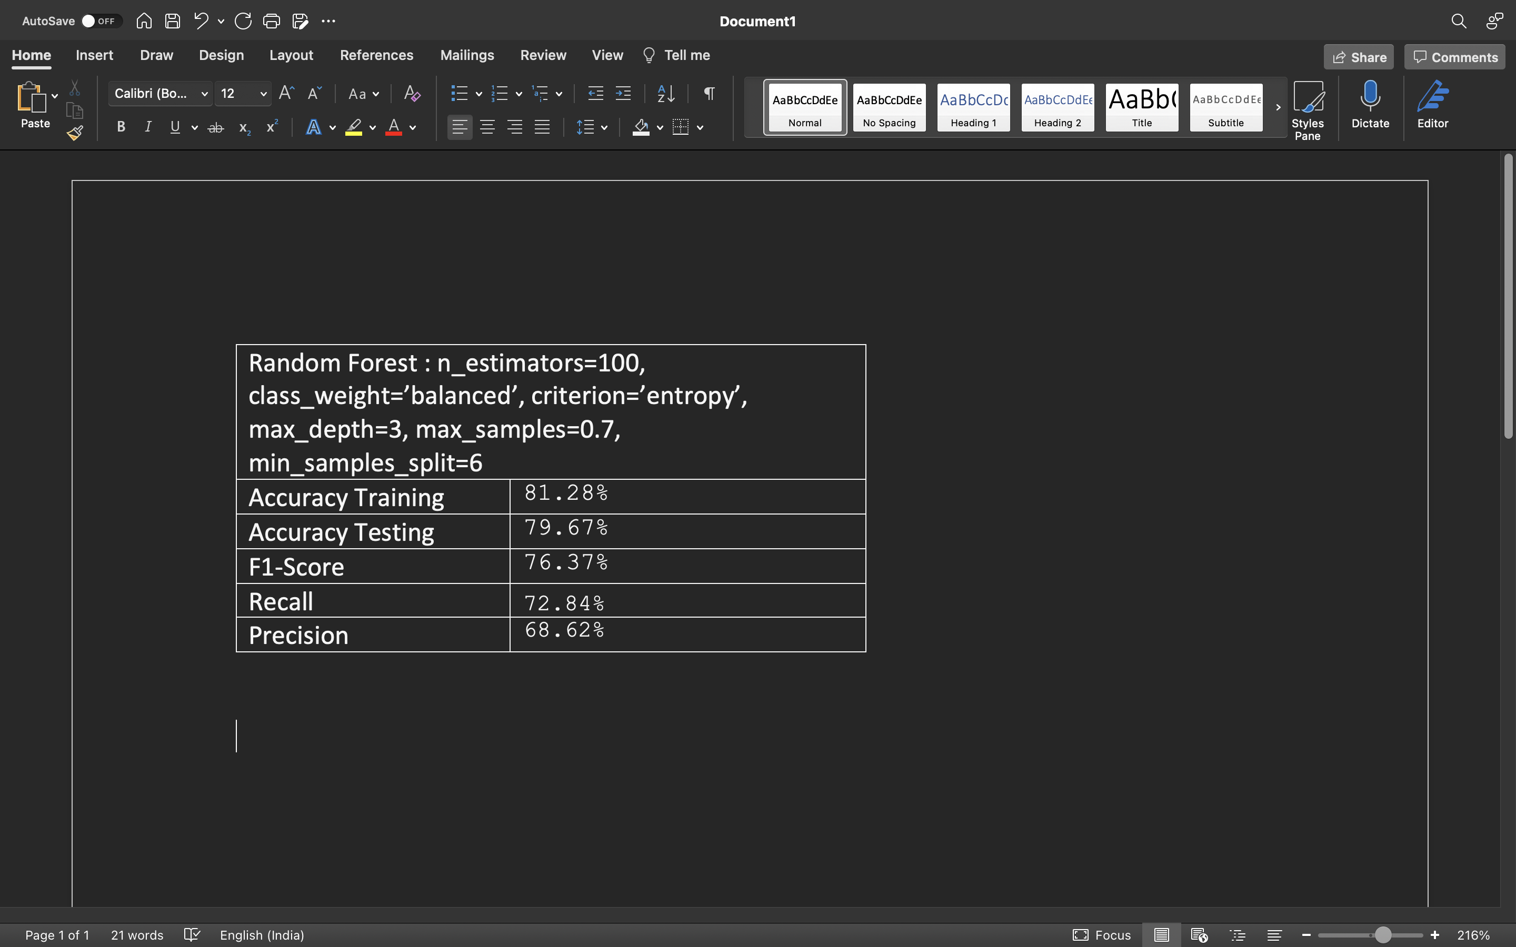
4.5 : Random Forest

Slide 29
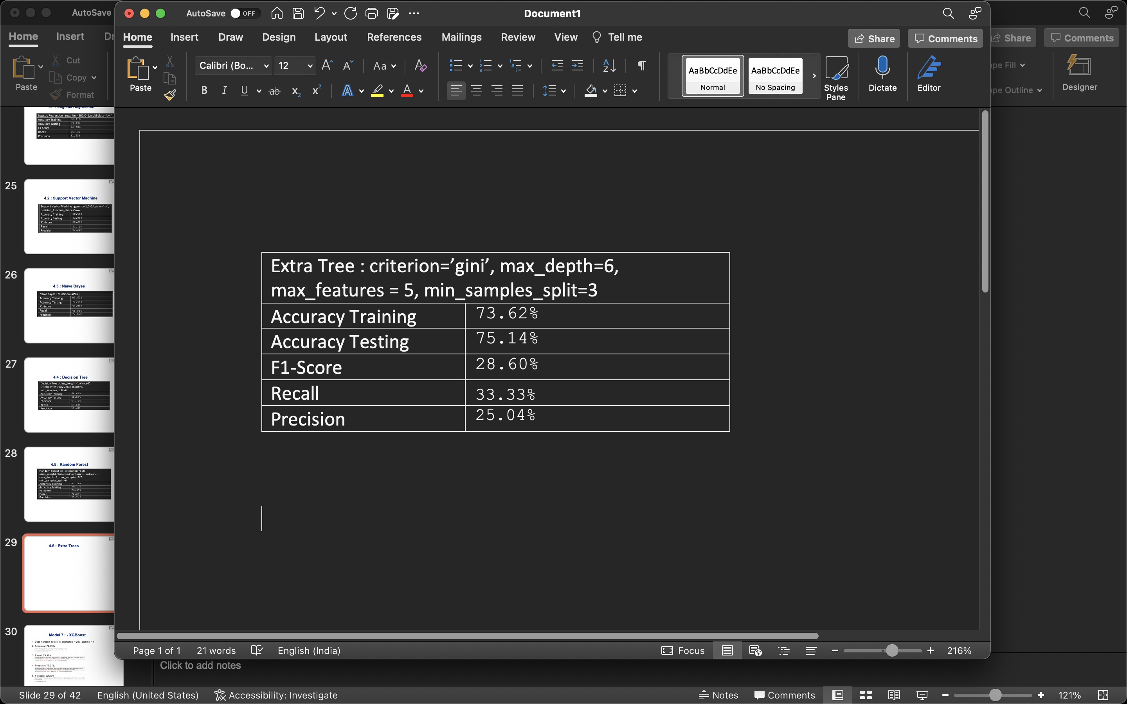
4.6 : Extra Trees

Slide 30
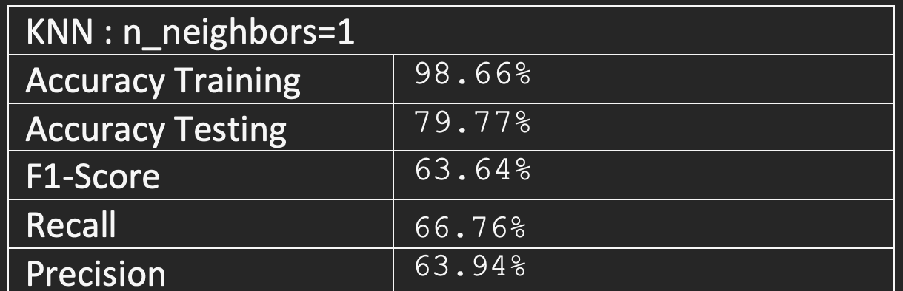
4.7: K-Nearest Neighbors (KNN)

Slide 31
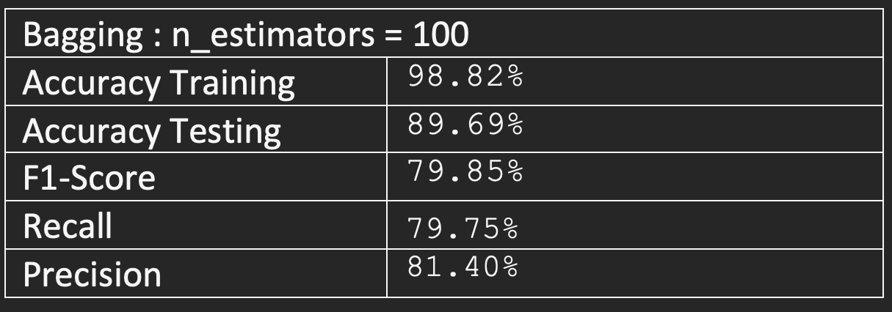
4.8 : Bagging

Slide 32
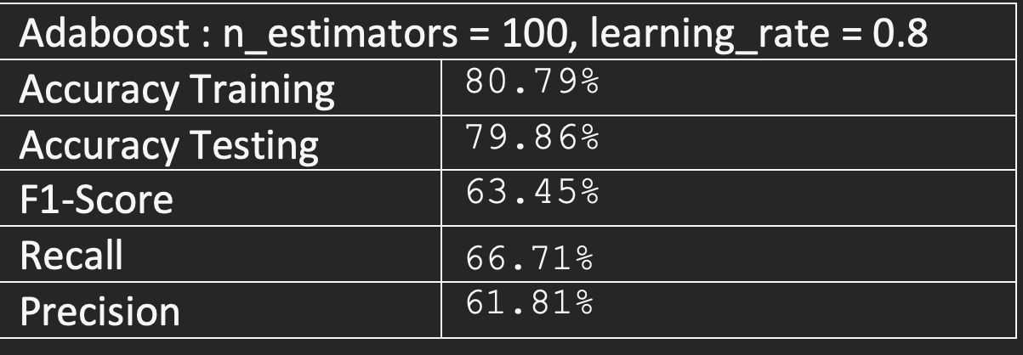
4.9 : Adaboost

Slide 33
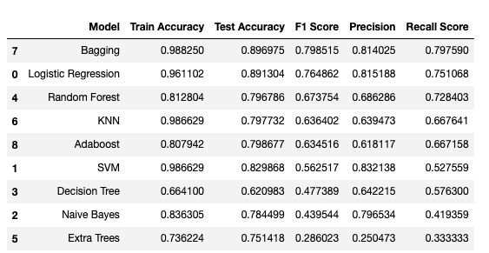
5. Model Comparison

Slide 34
Model Results
Bagging classifier has given the highest test accuracy. Therefore, we have chosen Bagging for deployment.

Slide 35
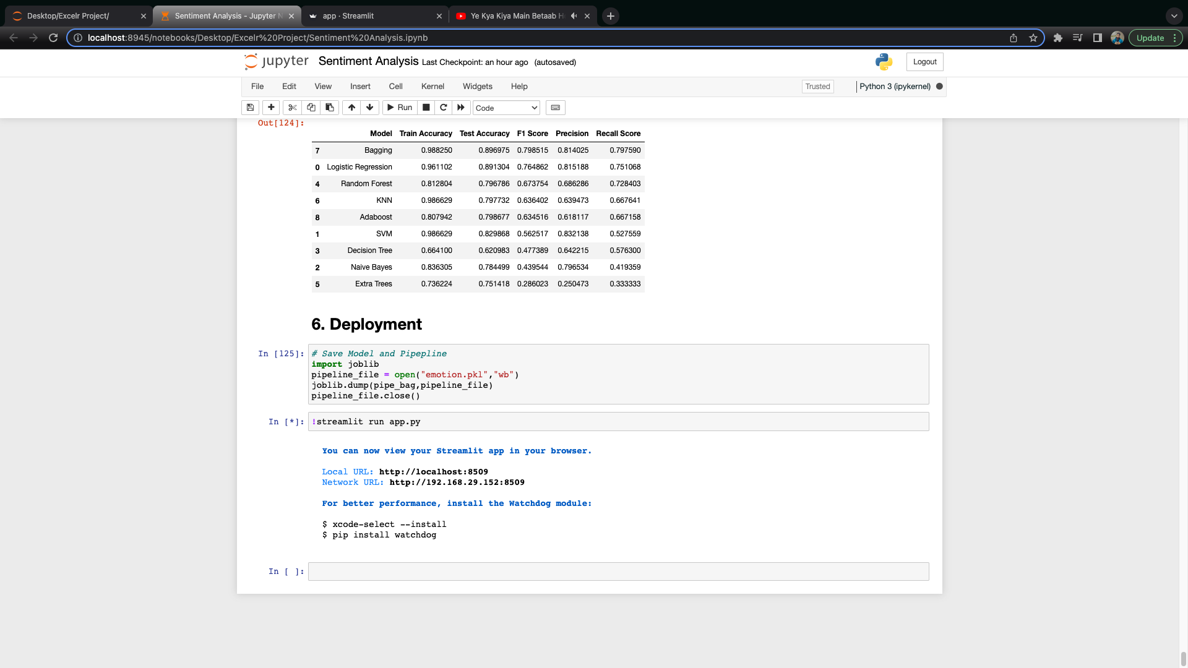
6. Model Deployment

Slide 36
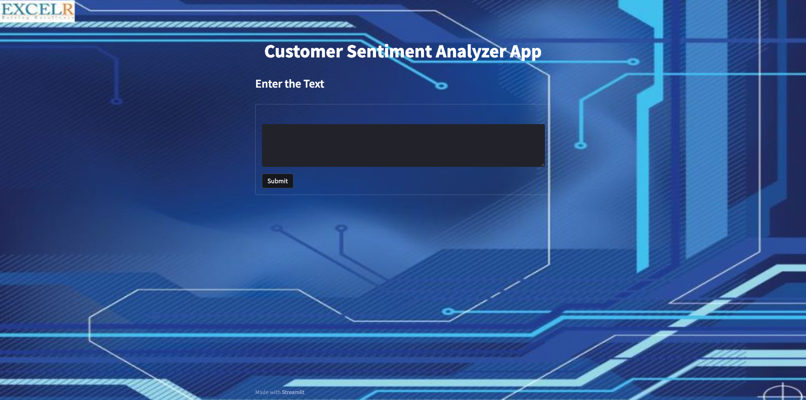
Streamlit App

Slide 37
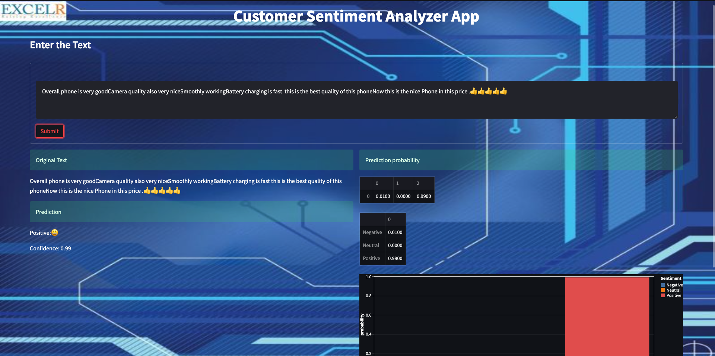
Streamlit App – Positive Sentiment

Slide 38
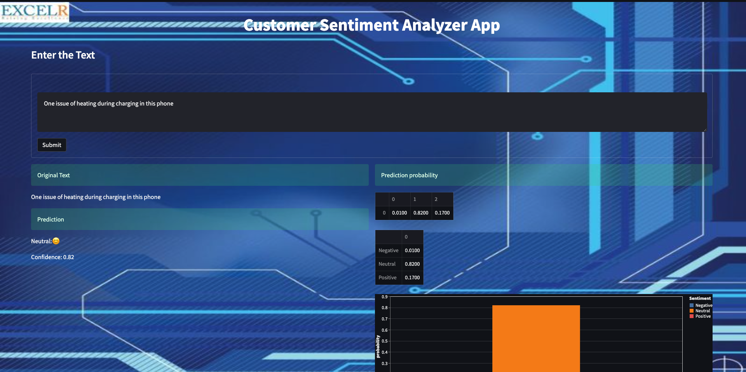
Streamlit App – Neutral Sentiment

Slide 39
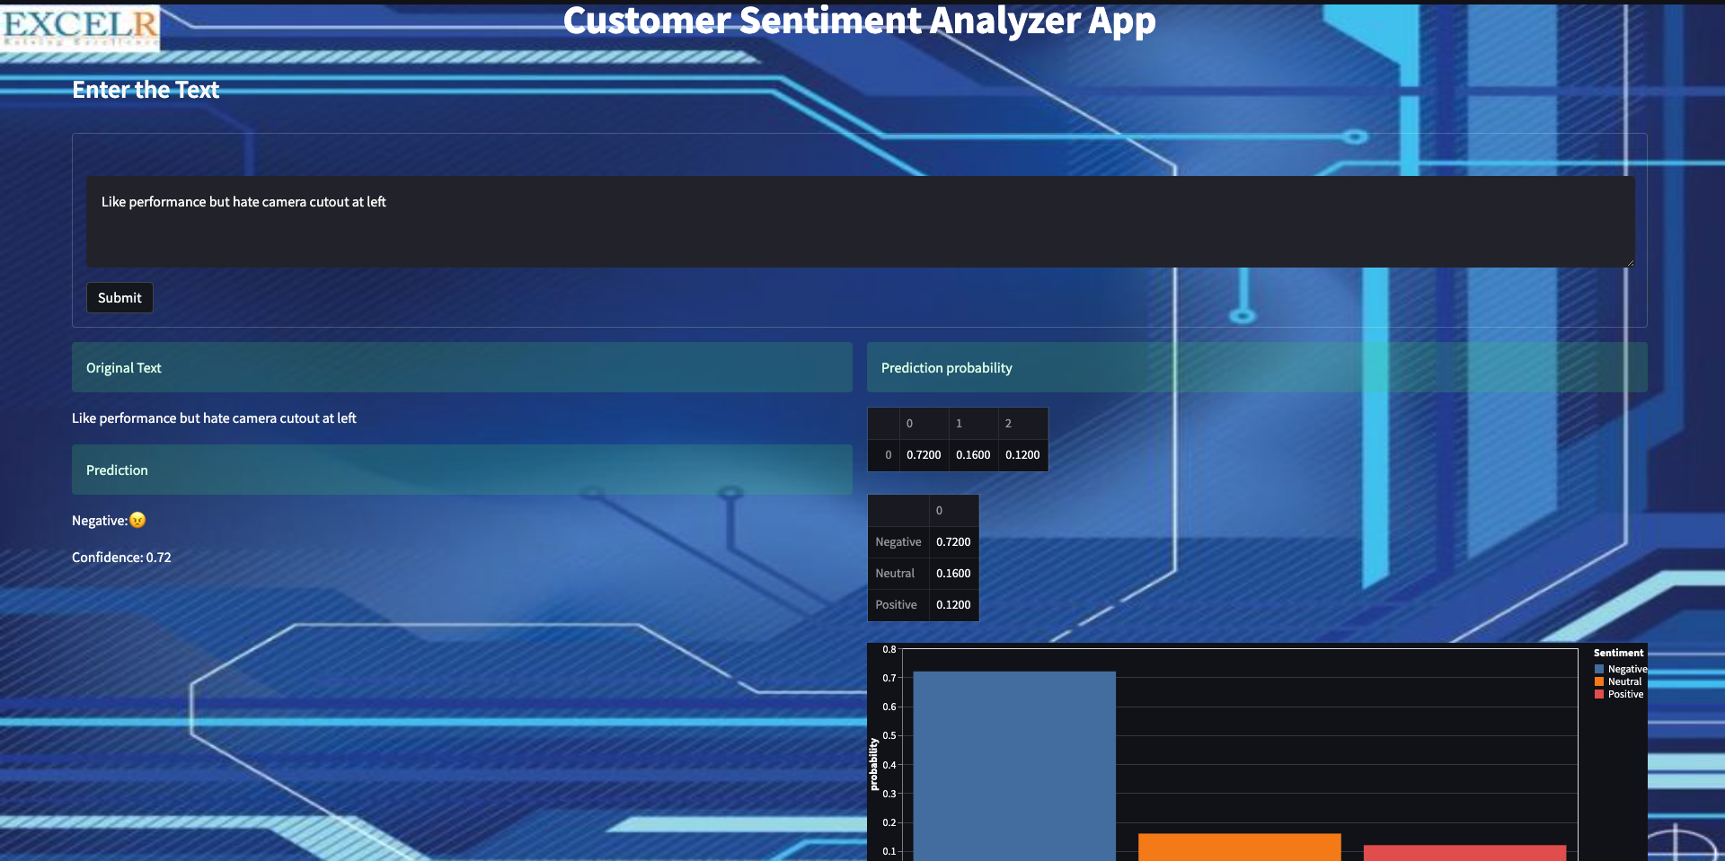
Streamlit App – Negative Sentiment

Slide 40
Challenges faced?
Finding the best project framework for deployment.
How did you overcome?
We discussed by connecting on meeting and everyone suggested streamlit for deployment.

Slide 41
Thank you!

